Slide 1
Giving Thanks: Looking at the 19-20 IE Cycle and Beyond
Dr. Dan Su
Mary Cheek
Alison Soeder
Tracy Stewart

Slide 2
Notes:
(Dan)
We’re thankful for your participation in assessment and commitment to continuous improvement.
Assessment requires the contributions of many faculty and staff from across the campus and we thank you for your time and energy invested in assessing the programs and services we offer to students, faculty and staff.
As a small token of our appreciation, we’re happy to be able to share a small gift item which each of today’s virtual gathering attendees. Your gift will be distributed to your departmental office for pickup.

Slide 3
Recognitions
New Plans This Year
BS Agricultural Science & Technology – Leadership & Communication emphasis
BS Sustainable Agriculture and Food Systems
MS Public Health
Office of Latinx Engagement and Outreach
Institute for Competency-Based Education
Success Teams – Academic Advising
Success Teams – Concierge
Success Teams – Financial Aid
Notes:
(Dan)
We’d like to recognize our programs and support units that are new this year for assessment.
BS Agricultural Science & Technology – Leadership & Communication emphasis
BS Sustainable Agriculture and Food Systems
MS Public Health
Office of Latinx Engagement and Outreach
Institute for Competency-Based Education
Success Teams – Academic Advising
Success Teams – Concierge
Success Teams – Financial Aid

Slide 4
Recognitions
New or Returned to IE This Year
Erica Contreras
Jeremy Gamez
Sandy Barnes
Priscilla Nichols
Eddie Pinckard
Nechell Bonds
Renee Walker
Dustin Pearson
Sherri Harwell
Denise Neill
Steve Prewitt
Kriss Kemp-Graham
Karin Tochkov
Erika Schmit
Michael Opara
Ruilang Yan
Celine Hoe
Judy Sackfield
Carlos Rivers
Quynh Dang
George Swindell
Jimmy Womack
Julia Meszaros
Brian Zator
Maggie Salem
Keith Frost
Jessica Adams
Chad Smith
Becky Sinclair
Kimberly McLeod
Erin Harper
Karen Allen
Notes:
(Dan)
We’d also like to say thanks and welcome to all those who are new or returned to participating in IE this year. (don’t have to read all the names)

Slide 5
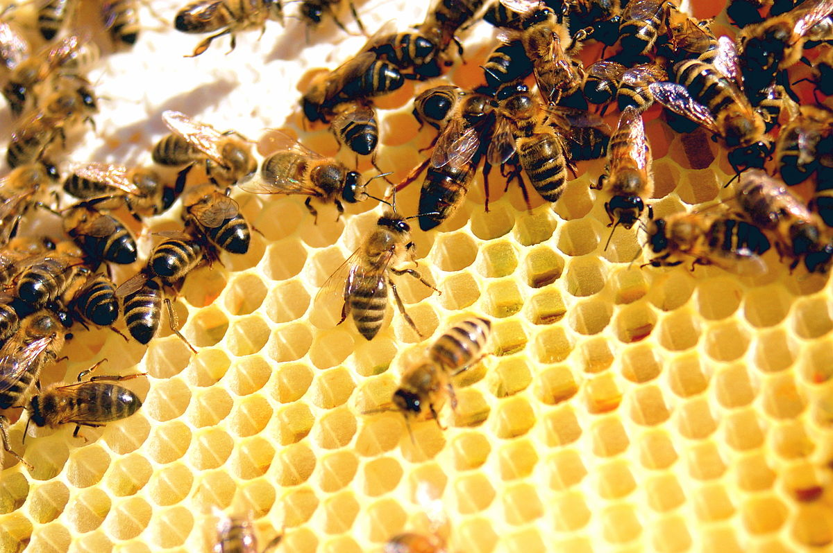
Recognitions
Most SLOs in Assessment Plan
BS Environmental Science (10)
BA/BS Kinesiology & Sports Studies – All Level Teacher Certification track (10)
BSW Social Work (10)
MSW Social Work (10)
Most Goals in Assessment Plan
VP-Enrollment Management (7)
Worker Bees!
Notes:
(Dan)
We’ve got some “worker bees” among us! In recognition of programs and support units with the most SLOs and goals to assess.
Most SLOs in Assessment Plan
BS Environmental Science (10)
BA/BS Kinesiology & Sports Studies – All Level Teacher Certification track (10)
BSW Social Work (10)
MSW Social Work (10)
Most Goals in Assessment Plan
VP-Institutional Advancement (10)

Slide 6
Most Rubric Reviews
Support Unit IE Rep with the Most Reports to Review
Steve Hirst – 21 support units
Academic Program IE Rep with the Most Reports to Review
David Scott – 34 academic programs
Notes:
(Dan)
Also a shout-out to our IE Representatives who have the most IE reports to review. We appreciate your work on behalf of your areas!
Support Unit IE Rep with the Most Reports to Review
Steve Hirst – 21
Academic Programs IE Rep with the Most Reports to Review
David Scott – 34

Slide 7
Mac Users
Notes:
(Dan)
We know some of you Mac users had some problems using Nuventive and being able to read all of the fields for entry. Thanks for your patience! Nuventive is working on a permanent fix for this.

Slide 8
Most Patient TrainTraq Trainees
Notes:
(Dan)
We know some of you experienced technical difficulties with the Nuventive training course on TrainTraq. Thanks for helping bring those to our attention so that we could work with Training & Development to resolve them. We appreciate the time you spent learning the new platform.

Slide 9
Most Challenging Response to Assessment During Pandemic
Notes:
(Dan)
We also know how challenging assessment was for some with the transition to online learning and remote work, in some cases. Thank you for finding innovative ways to continue assessment and to continue assessing for quality even during a time of change. The information you’ve been able to collect will help the university best serve our students, faculty and staff.

Slide 10
Due Date & Submission Status
Due date moved to September 1st
Results and Plan due date consolidated into a single date
Opportunity to carryover existing SLOs/Goals and Assessment Methods to next year’s plan rather than resubmitting a duplicate plan
Direct email reminders to IE Authors through listserv
Notes:
(Alison)
Yes, a big thank you to all of our IE Authors, Representatives, and Reviewers who took part in our 2019-20 IE cycle. As you know, there were a few changes this year to our due date and submission procedures.
Due date moved to September 1st
Results and Plan due date consolidated into a single date
Opportunity to carryover existing SLOs/Goals and Assessment Methods to next year’s plan rather than resubmitting a separate, duplicate plan
The IE Team sent direct email reminders to IE Authors through new email listserv IEAuthors@tamuc.edu

Slide 11
Notes:
(Alison)
So how did it go? Here’s a comparison of our submission status as of our due dates for the two prior IE cycles.
2017-18 Cycle
41% of results submitted by due date; 36% of plans submitted by plan due date
2018-19 Cycle
Some improvement
62% of results submitted by results due date; 39% of plans submitted by plan due date

Slide 12
Notes:
(Alison)
For comparison, this year, with a single due date for results and plan information
Support Units
67% of assessment methods had results entered
61% of Plans had Goals entered
Academic Programs
82% of assessment methods had results entered
71% of Plans had SLOs entered
Our submission rate is continuing to improve, made easier by Nuventive, and this helps the information be available in a timely manner for subsequent reviewers and users of the data.

Slide 13
Implementation of the Nuventive Improvement Platform
200+ users trained
20+ training resources and videos added to the IER website
Live and on-demand training sessions
Single sign on integration
Web-based access
Notes:
(Alison)
Of course another change this year was the implementation of the Nuventive Improvement Platform for documentation of assessment plans and results. Nuventive serves as a digital repository of assessment data which is more accessible for IE Authors and reviewers.
Some highlights of the implementation include
200+ users trained
20+ training resources and videos added to the IER website
Live and on-demand training sessions
Single sign on integration
Web-based access

Slide 14
Nuventive User Training Results
Notes:
(Alison)
After collecting your feedback, here’s what we can share about what you told us of your experience with Nuventive and the IE cycle
After completing the basic user training,
82% thought the Nuventive Improvement Platform was easy to navigate

Slide 15
Nuventive User Training Results
Notes:
(Alison)
82% felt comfortable using the Nuventive Improvement Platform after the training

Slide 16
Nuventive User Training Results
73%
Of respondents were satisfied overall with the training
Notes:
(Alison)
73% of respondents were satisfied overall with the training

Slide 17
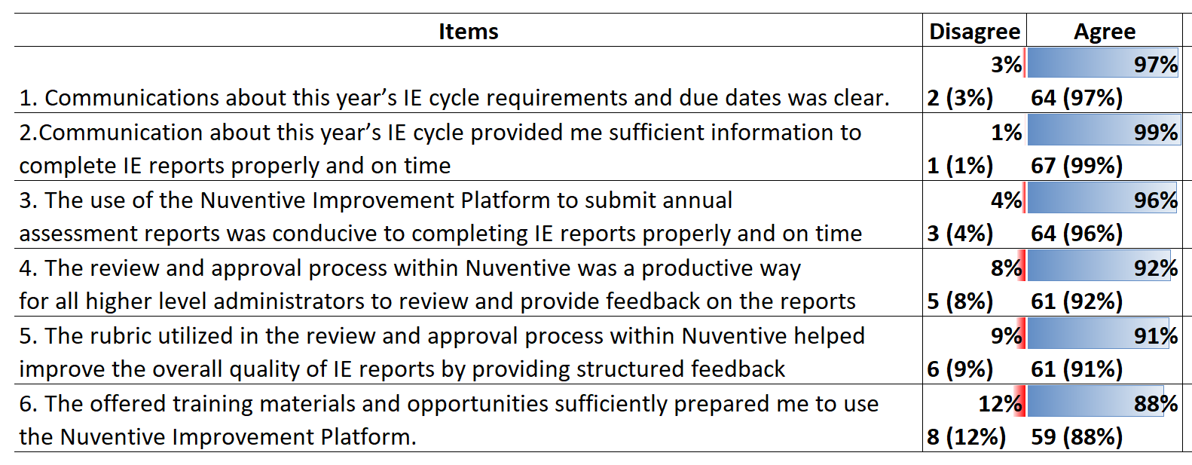
Results of IE Feedback Survey
Highest-Rated Nuventive Features
The ability to carry over existing SLOs/Goals and assessment methods rather than submitting a new plan each year
Login access via single sign on
A document library to house files and documents related to my assessments
Notes:
(Alison)
We also conducted a end-of cycle survey of IE Authors, Reps, and Reviewers to hear about your experience with the IE cycle, with Nuventive, and your interest in future training topics. 67 responses in total.
The Nuventive features which were rated the highest by respondents included—
The ability to carry over existing SLOs/Goals and assessment methods rather than submitting a new plan each year
Login access via single sign on
A document library to house files and documents related to my assessments
In general respondents were satisfied with the facilitation of this year’s IE cycle, but 12% disagreed that the offered training materials sufficiently prepared them to use the Nuventive Improvement Platform. There was also some dissatisfaction with the review and approval process and rubric utilization, although a majority agreed these were productive for providing feedback on IE reports.
Additionally, we collected open-ended feedback about what worked well and what didn’t work well with the platform which we will review and use to improve our resources and trainings for the coming year. Thank you for your feedback.

Slide 18
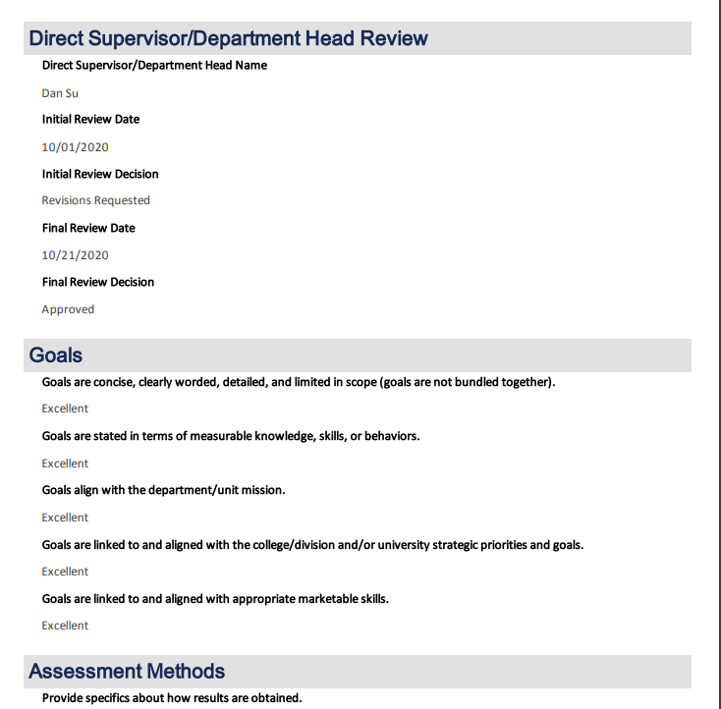
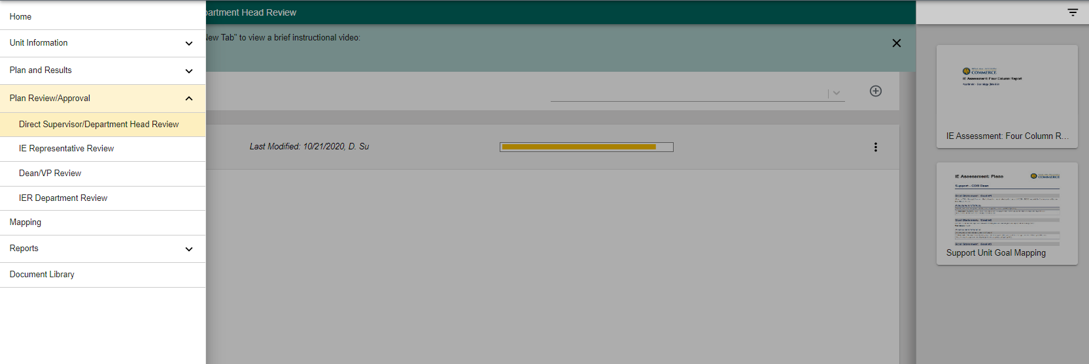
Review & Approval Process
Electronic facilitation of review and approval signatures in the Nuventive platform
Rubric to structure review and requests for revisions
Reports to monitor approval status
Notes:
(Mary)
Another new feature of this cycle was the review and approval form, including rubric
Electronic facilitation of review and approval signatures in the Nuventive platform, replacing the pdf signature pages and file transfer system
Rubric to structure review and requests for revisions
Reports to monitor approval status

Slide 19
Results of Rubric Review
All Rubrics Collected
Overall average rating 2.31
Highest rated item overall Results are dated during the reporting year.
Lowest rated item overall The report clearly demonstrates “closing the loop.”
Notes:
(Mary)
A look at the collected rubric data shows
Overall average rating 2.31 (3 points scale , 1=Revise, 2=Acceptable, 3=Excellent)
2% ratings = revise; 66% = Acceptable; 32% = Excellent
Highest rated item overall Results are dated during the reporting year.
Lowest rated item overall The report clearly demonstrates “closing the loop.”

Slide 20
Results of Rubric Review
Rubric Section | Average Rating
SLOs/Goals | 2.33
Assessment Methods | 2.31
Results | 2.31
Actions/Use of Results | 2.23
On average, rubric items related to SLOs and Goals received the highest ratings overall, while rubric items related to Actions/Use of Results received the lowest ratings.
Notes:
(Mary)
Here you can see the average rating for each section of the rubric.
Very similar overall. On average, rubric items related to SLOs and Goals received the highest ratings overall, while rubric items related to Actions/Use of Results received the lowest ratings.

Slide 21
Results of Rubric Review
Department Heads/Supervisors – Academic Programs
2.49
IE Representatives – Academic Programs
2.29
IE Representatives – Support Units
2.20
Department Heads/Supervisors – Support Units
2.15
Notes:
(Mary)
And interesting to note just slight differences in how the different roles rated the reports, with Academic Department Heads giving, on average, higher ratings, and Support Unit Department Heads/Direct Supervisors giving on average lower ratings.

Slide 22
Looking Ahead - Nuventive Trainings
Basic User Training
Required for all new users
Also available as a refresher course
Report Completion Training
Offered leading up to the reporting due date
How and where to enter required information to complete annual report
Reviewer Training
Offered leading up to the review and approval due dates
How to use monitoring reports in Nuventive
TrainTraq or live options
How to use review rubric
Notes:
(Mary)
Looking ahead, a few notes on the Nuventive-related trainings we plan to offer.
Continue to require basic user training of all new users – on TrainTraq or via periodic live trainings. May also attend for a refresher
Introduction of pre-cycle trainings focused on steps to complete entry of annual report
Continuation and expansion of trainings for reviewers

Slide 23
Looking Ahead - Virtual Spring Series Workshops
Notes:
(Mary)
We’ll also continue to offer our spring series trainings on the fundamentals of assessment, in a virtual format this spring on Zoom. Be watching for more information.
Most requested training topics from Feedback Survey will be covered, including
Developing SLOs/Goals
Selecting and implementing assessment methods
Analyzing data and interpreting results

Slide 24
Looking Ahead – Quality of Assessment
Results with Standard of Success Not Met or Inconclusive
Assessment during COVID
Actions/Use of Results
Assessment Review Rubric and College/Division Outreach
Notes:
(Mary)
As we move past the initial Nuventive user training, we will also have a chance to focus our attention more on the quality of assessment.
This year we saw a relatively high number of results with a conclusion marked Standard of Success Not Met or Inconclusive

Slide 25
Notes:
(Mary)
For example, here you can see the percentages of results marked inconclusive or standard of success not met for academic programs and for support units.
Not meeting a standard of success can be a meaningful result and useful for continuous improvement purposes when we’re able to act upon what we’ve learned. However, a multi-year pattern of unmet results may suggest a need for intervention.
This year presented an unusual challenge with inconclusive results due to changes in response to the pandemic and in some cases an inability to conduct the assessment as planned. In other cases, a standard was not met or inconclusive because of transition in the individual responsible for assessment and a lack of continuity in assessment planning.

Slide 26
Looking Ahead – Quality of Assessment
Results with Standard of Success Not Met or Inconclusive
Assessment during COVID
Actions/Use of Results
Assessment Review Rubric and College/Division Outreach
Notes:
(Mary)
To help us establish a consistent pattern of assessment, we encourage you to document well your assessment plan and involve other faculty or staff in your area in assessment so that in the case of transition of a single individual, others will be able to continue the assessment plan in their absence.
With the continued emphasis on online learning and disruption to normal face-to-face services and experiences, we also encourage you to be thinking about any changes you need to make to how you conduct your assessment methods this year, for collection of 20-21 results. If you need any assistance in planning for this, please reach out to our office.
And, when a standard of success is not met or inconclusive, please be sure to document a specific clear action item which describes how you will use the results to seek improvements in the related goal or learning outcome area. For academic programs, this should be an action related to curriculum or pedagogy. For support units, this should be an action related to how you operate.
These are a couple opportunities to be looking at the quality of assessment in your areas. Our office also plans to individually work with colleges and divisions over the coming year to provide feedback on IE reports in each area and to learn how we can best assist assessment practices in your area. We’ve made a lot of progress institutionally growing a culture of assessment and we look forward to continuing to grow together.

Slide 27
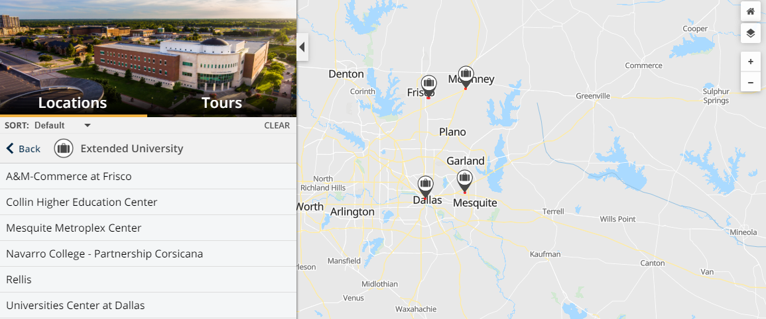
Included in Assessment
Student Learning Outcomes for Academic and Student Support Services
Online and Off-Site Students, Services, and Programs
Notes:
(Mary)
A couple areas of continued growth include
Assessment of student learning outcomes for academic and student support services. Those units that serve students directly may need to incorporate assessment of their impact on student learning and behavior. We’ve designated these units in the General Information page of your Nuventive profile if you would like to check if this applies to your support unit. Or contact us for more information. We will continue to share reminders and opportunities for training related to this initiative.
Assess of online and off-site programs and services.
For academic programs, that means making sure students in online programs or programs offered at off-site locations are included in assessment, and being able to identify their assessment results by location or instructional modality when the program is offered at multiple locations or modalities
For support units, that means making sure to assess the services you offer to online or off-site students/faculty/staff and being able to identify their assessment results by location or service modality when the service is offered to students at multiple locations or in multiple modalities
Contact us with questions

Slide 28
Looking Ahead to Reaffirmation
2024
reaffirmation year
SACSCOC
2023 compliance certification due
2020-2021
IE Reports
2021-2022
IE Reports
Notes:
(Mary)
All of your commitment to consistently assessing and reporting on assessment has contributed to our recent compliance with assessment related standards for academic programs in the university’s 2020 Fifth-Year Interim Report submitted to SACSCOC this past spring. We hope to continue this progress toward quality assessment as we lead up to our 2024 reaffirmation of accreditation. We have 2 primary reporting years that will be included in what we submit to SACSCOC for review in 2023, so it is especially important to continue building the quality and consistency of what we report over the 20-21 and 21-22 IE reporting years. The whole university community is supported by your efforts and we’re here to support you in this assessment work, so please let us know how we can help you continue to strengthen your assessment practices.

Slide 29
We’d love to hear from you!
Check out our events
www.tamuc.edu/ier - click IER Events
Check out our resources
www.tamuc.edu/ie
Contact our staff
Dan.Su@tamuc.edu, Executive Director of Institutional Effectiveness and Research
Mary.Cheek@tamuc.edu, Institutional Effectiveness Officer
Alison.Soeder@tamuc.edu, Assessment Specialist
Tracy.Stewart@tamuc.edu, Administrative Coordinator
Request general assistance with assessment or Nuventive
IE@tamuc.edu
Notes:
(Mary) – Here are a couple ways you can reach us. (Leave up on screen while questions are asked, as time permits)
(Tracy – Q&A facilitation, if time allows)

