Slide 1
Quizzes and Exams Question Pools in D2L

Slide 2
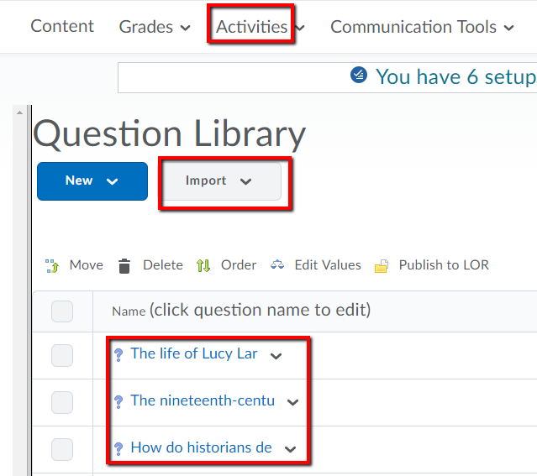
First--Move Questions to the Question Library
In course:
Click on Activities
Select Quizzes
Click on Question Library
Click on dropdown arrow for New
Select Section under New
Give a Section Name
Click Save
Click on New Section Name
Click on Import
Select Browse Existing Questions
Click on dropdown menu beside Source
Select the Source of the Questions for your New Section
Select the questions you want to use
Click Add

Slide 3
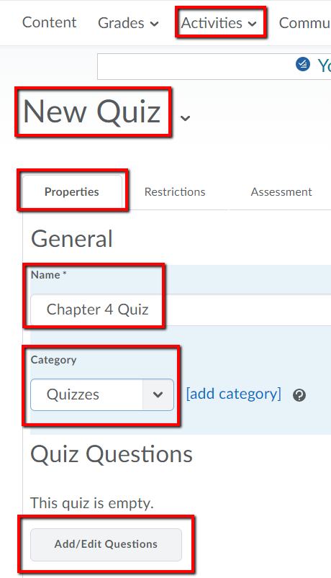
Second—Build a New Quiz
In course:
Click on Activities
Select Quizzes
Click on New Quiz
On Properties tab, enter Name of Quiz
Assign to a Category
Click Add/Edit Questions

Slide 4
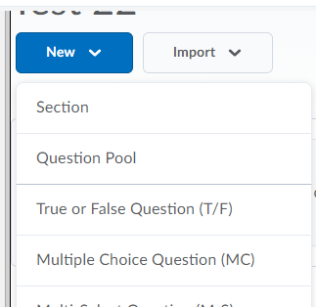
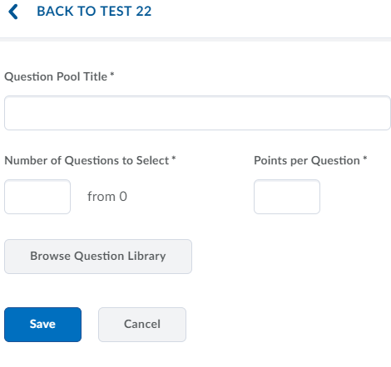
Third—Add Questions
In course:
Click on New
Select Question Pool
Enter Section Name
Click Browse Question Library

Slide 5
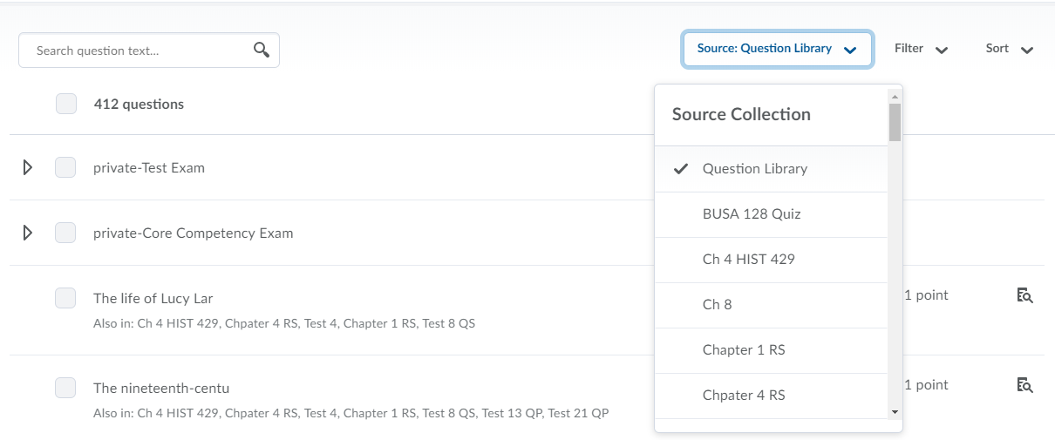
Fourth—Add Questions
In course:
Click Question Library
Select Source Collection
Select Question Source

Slide 6
Fifth—Add Questions
In course:
Select Questions
Click Add

Slide 7
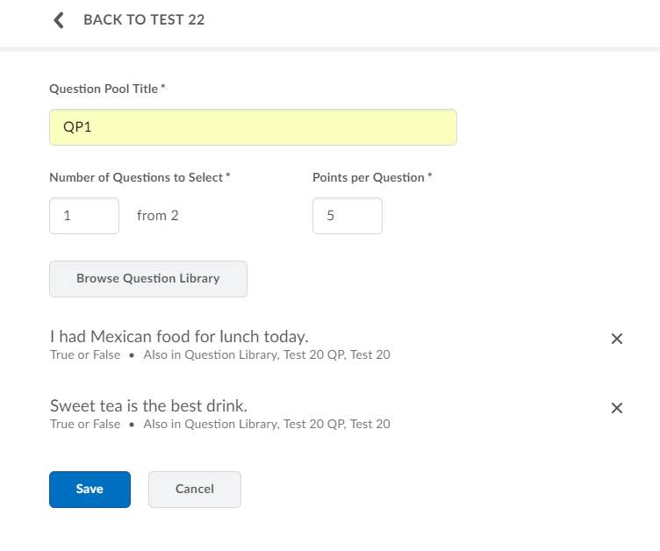
Sixth—Add Questions
In course:
Add Number of Questions to Select
Add Points per Question
Click Save

Slide 8
Seventh—Add Questions
In course:
Click Done Editing Questions

Slide 9
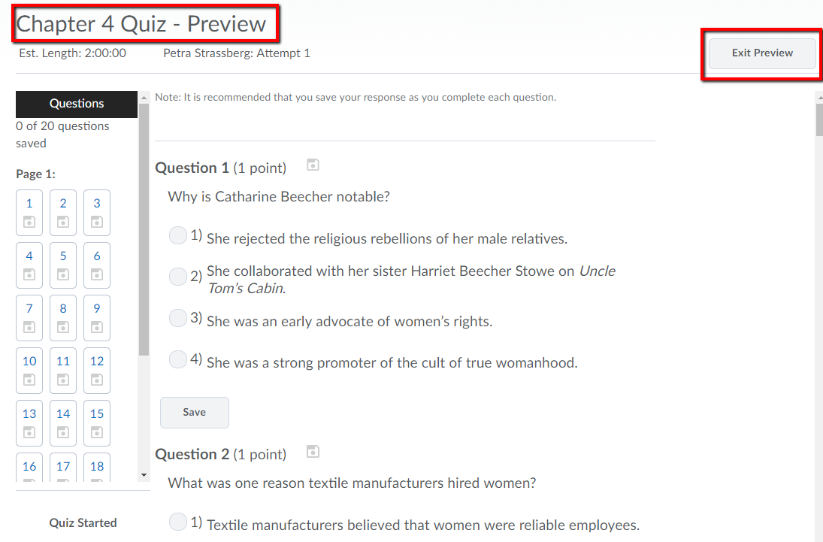
Eighth—Set Questions per Attempt
In Random Screen:
In the Restrictions tab select Active
Set Start and End Dates
Select Preview
Select Exit Preview

Slide 10
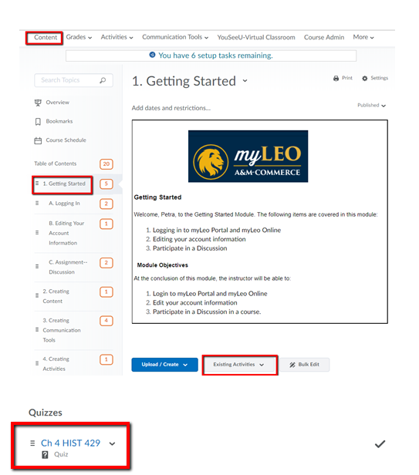
Ninth--Relink Quiz to Module
In course:
Click on Content
Select Module to enter quiz
Click on Existing Activities
Click on Quizzes
Click on the desired Quiz
Quiz appears below Module

Slide 11
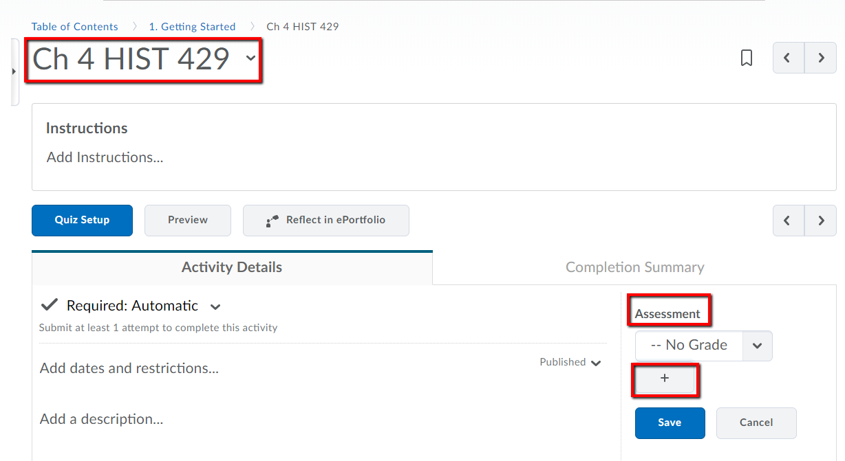
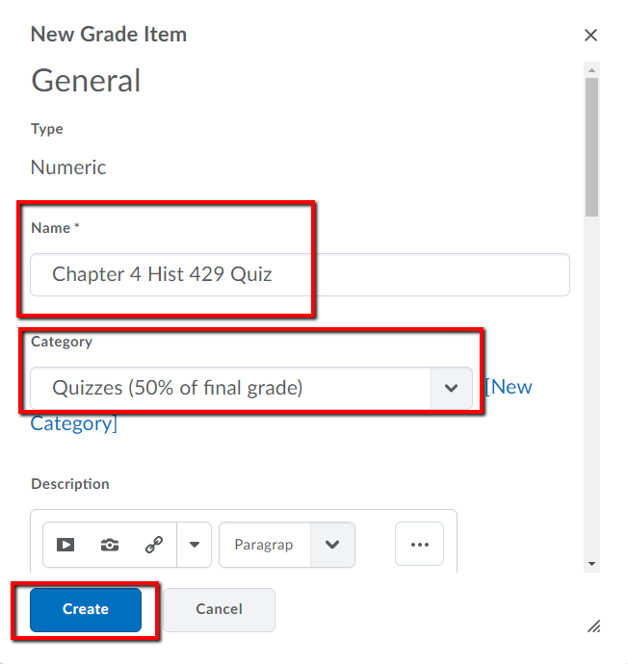
Tenth--Associate with the Gradebook
Under the Module:
Click on the Quiz
Click Assessment
Click the + sign
In the New Grade Item box:
Enter grade item Name
Select/ Add Category
Add Points and Weights
Click Create
Click Save

Slide 12
Conclusion and Resources
If you have questions or wish additional information, please, contact :
Office of Academic Technology
Gee Library, Suite 173
903-886-5511
online@tamuc.edu

