Slide 1
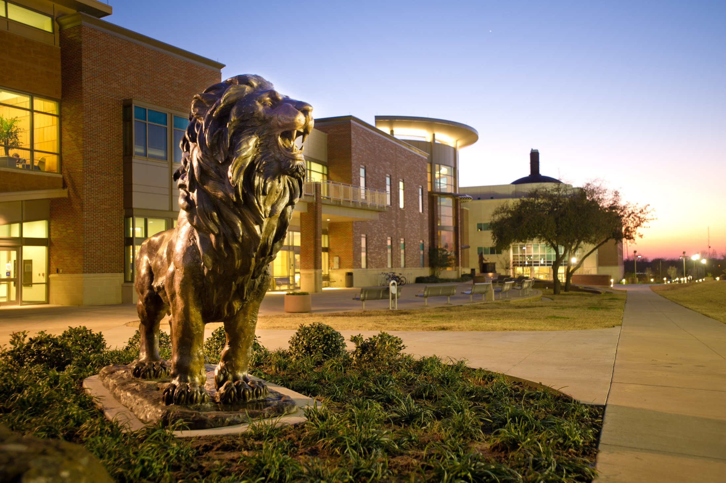
FAST FACTS
INSTITUTIONAL RESEARCH
Academic Year 2019-2020
Source: http://www.tamuc.edu/IER

Slide 2
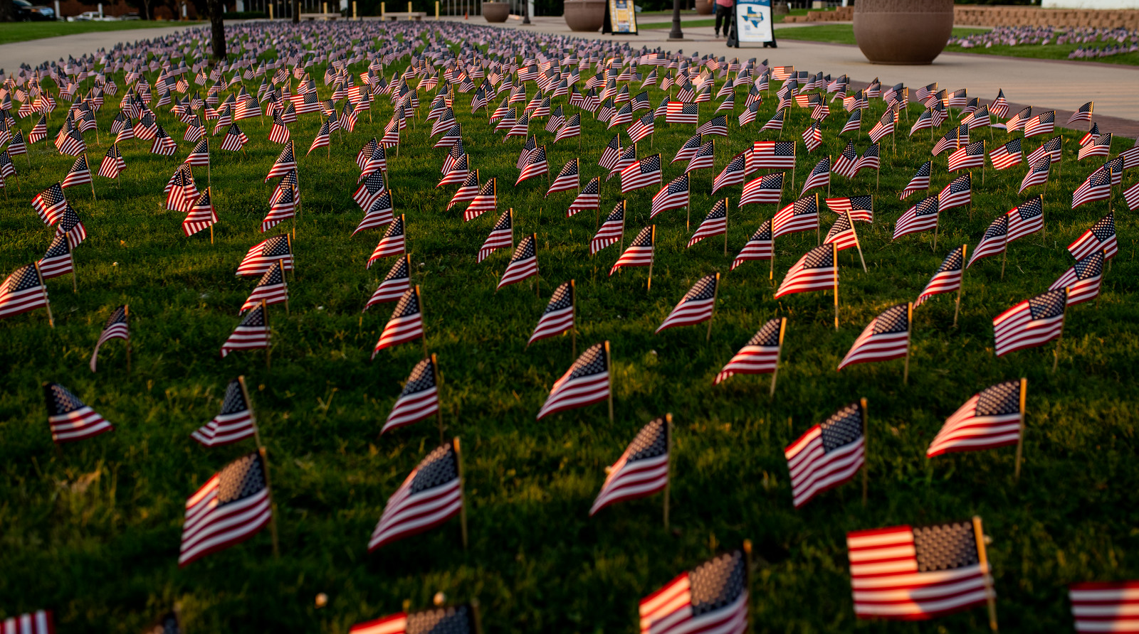
New Freshman Applied Admitted & Enrolled by gender
Fall 2019
 | Male | Percent* | Female | Percent* | Total | Total Percent*
Applied | 4331 |  | 6234 |  | 10565
Admitted | 1542 | 36% | 2245 | 36% | 3787 | 36%
Enrolled | 519 | 34% | 680 | 30% | 1199 | 32%
*Admitted as a percentage of Applied, and Enrolled as Percentage of Admitted.
Source: Local Banner Data, not certified

Slide 3
SAT/ACT Comparison for Enrolled Students
Fall 2019
SAT Evidence Based Reading and Writing
SAT Math
ACT Composite
Source: Local Banner Data, not certified; only tests taken in 2019 included.
SAT Averages from The College Board 2019 Report
Notes:
SAT Writing data is not available for 2017.

Slide 4
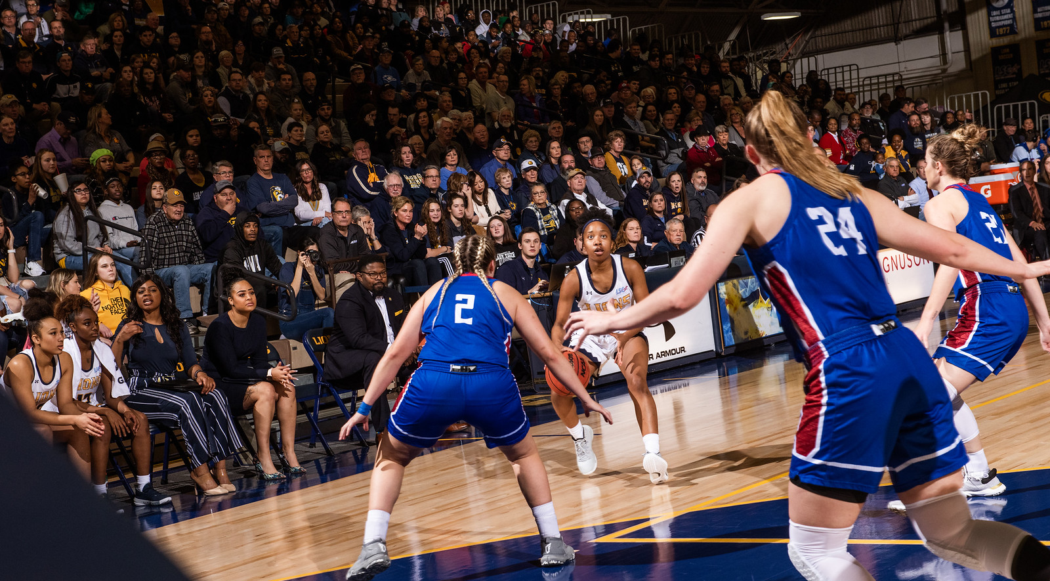
One Year PERSISTENCE Rate
First-Time, Full-Time Undergraduate
Entering Cohort Fall 2018, as of Fall 2019
 | Count | Persistence Rate
Same institution | 729 | 69.3%
Other Texas institution | 147 | 14.0%
Total | 876 | 83.3%
Source: Accountability Report
Notes:
Total cohort isn’t mentioned in the white ppt so persistence rate may differ.

Slide 5
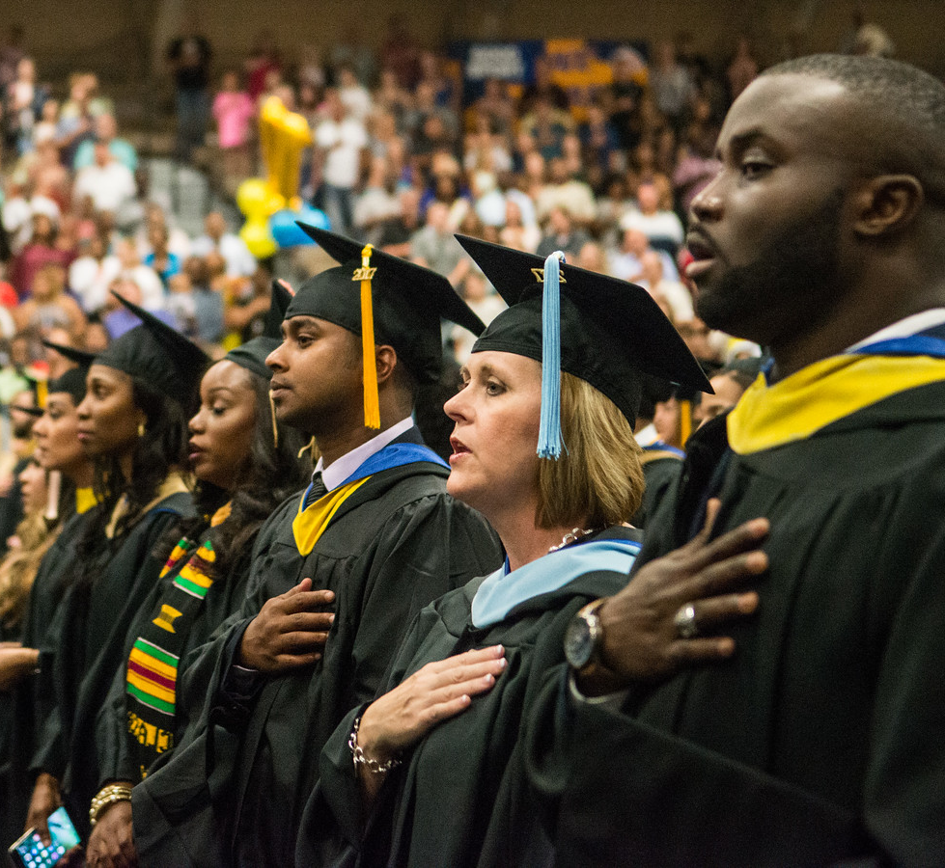
Graduation Rate as of 2019
 | ENTERING FALL COHORT | COUNT | PERCENT
4-Year Graduation Rate | 2015 | 1,006 | 29.9%
* Same Institution |  |  | 25.6%
* Other Texas Institution |  |  | 4.3%
5-Year Graduation Rate | 2014 | 991 | 46.4%
* Same Institution |  |  | 38.6%
* Other Texas Institution |  |  | 7.8%
6-Year Graduation Rate | 2013 | 928 | 52.5%
* Same Institution |  |  | 42.9%
* Other Texas Institution |  |  | 9.6%
Source: Accountability Report

Slide 6
Top Feeder Schools
First Time in College Fall 2019
High School | # Enrolled
Sulphur Springs High School | 26
Desoto High School | 25
Commerce High School | 20
Greenville High School | 20
Duncanville High School | 18
Rockwall High School | 18
Royse City High School | 18
Dr. John D Horn High School | 17
Lancaster High School | 17
Mesquite High School | 16
Source: CBM001, Certified Data

Slide 7
Age Distribution by Level
Fall 2019
Age | Undergraduate | Post Baccalaureate | Masters | Doctoral | Total | Percent
Under 18 | 514 | 0 | 0 | 0 | 514 | 4.38%
18-24 | 5,558 | 15 | 469 | 0 | 6,042 | 51.53%
25-29 | 841 | 16 | 750 | 23 | 1,630 | 13.90%
30-39 | 776 | 29 | 976 | 162 | 1,943 | 16.57%
40-49 | 370 | 20 | 483 | 177 | 1,050 | 8.96%
50 or older | 166 | 19 | 244 | 117 | 546 | 4.66%
Total | 8225 | 99 | 2922 | 479 | 11,725 | 100%
Source: CBM001, Certified Data

Slide 8
Enrollment by Demographic
Fall 2019
By Gender
FEMALE
7,253
61.86%
MALE
4,472
38.14%
Source: CBM001, Certified Data

Slide 9
Fall Enrollment Trend
10-Year
YEAR | HEAD COUNT
2010 | 10280
2011 | 10726
2012 | 11187
2013 | 11068
2014 | 11490
2015 | 12302
2016 | 12385
2017 | 12490
2018 | 12072
2019 | 11725
Source: CBM001, Certified Data

Slide 10
First-Time Transfer Students Top Feeder Schools
Fall 2019
Institution | Total
Dallas County Community College | 160
Paris Junior College | 158
Collin County Community College | 99
Navarro College | 88
Trinity Valley Community College | 63
Grayson County College | 34
Northeast Texas Community College | 29
Blinn College | 28
Tarrant County College | 24
Northwest Missouri State University | 22
Source: CBM001, Certified Data

Slide 11
Enrollment by Residency
Fall 2019
Residency | Count | Percent
In State | 10944 | 93%
Out of State | 214 | 2%
International | 567 | 5%
Total | 11,725 | 100%
Source: CBM001, Certified Data

Slide 12
Distribution of Total In-State Enrollment
Fall 2019
Distance | Students | Percent
50 Miles or Less | 5,044 | 46.6%
100 Miles | 4,205 | 38.9%
200 Miles | 410 | 3.8%
300 Miles | 782 | 7.2%
400 Miles | 251 | 2.3%
Over 400 Miles | 123 | 1.1%
Total | 10,815 | 100%
Source: CBM001, Certified Data. All Degree Levels

Slide 13
Enrollment BY geographic origin
Fall 2019
Top 10 Counties
Top 10 States
Top 10 Countries
County | # Enrolled
Dallas | 2562
Hunt | 1265
Collin | 1199
Tarrant | 626
Rockwall | 607
Denton | 377
Hopkins | 350
Kaufman | 333
Harris | 286
Lamar | 256
State | # Enrolled
Texas | 10944
California | 34
Oklahoma | 26
Arkansas | 15
Louisiana | 14
Missouri | 10
Virginia | 10
Pennsylvania | 9
Georgia | 8
Tennessee | 7
Country | # Enrolled
United States | 11158
Nepal | 211
India | 136
Korea | 69
Nigeria | 37
Bangladesh | 11
China | 8
Mexico | 7
Germany | 6
Viet Nam | 6
Source: CBM001, Certified Data. All Degree Levels

Slide 14
Top Program AREAS by Level Fall 2019
Classification | # Enrolled |  | Program AREAS
Undergraduate
 | 859 |  | Interdisciplinary Studies, General
 | 609 |  | Applied Arts & Sciences
 | 607 |  | Kinesiology and Exercise Science
 | 519 |  | Business Administration and Management, General
 | 344 |  | Criminal Justice/Safety Studies
 | 306 |  | Psychology, General
 | 270 |  | Music, General
 | 257 |  | Computer and Information Sciences, General
 | 223 |  | Animal Sciences, General
 | 215 |  | Accounting
GRADUATE
 | 541 |  | Business Administration and Management, General
 | 322 |  | Accounting
 | 198 |  | Business Analytics
 | 140 |  | Curriculum and Instruction
 | 130 |  | Counselor Education/School Counseling and Guidance Services
 | 124 |  | Computer and Information Sciences, General
 | 110 |  | Educational Leadership and Administration, General
 | 108 |  | Library and Information Science
 | 104 |  | Social Work
 | 85 |  | Finance
Doctoral
 | 203 |  | Educational Leadership and Administration, General
 | 84 |  | Higher Education/Higher Education Administration
 | 76 |  | Elementary Education and Teaching
 | 53 |  | Counselor Education/School Counseling and Guidance Services
 | 37 |  | English Language and Literature, General
 | 26 |  | Educational Psychology
Source: CBM001, Certified Data.

Slide 15
Undergraduate Tuition & Fees
Academic Year 2019-2020
 | In-state | Prior Year | Out-of-State | Prior Year
Average Tuition | $4,790 | $4,790 | $17,460 | $17,240
Required Fees | $4,168 | $3,958 | $4,168 | 3$,958
Dollars Per Credit Hour | $160 | $160 | $582 | $575
Source: IPEDS Institutional Characteristics 2019-20

Slide 16
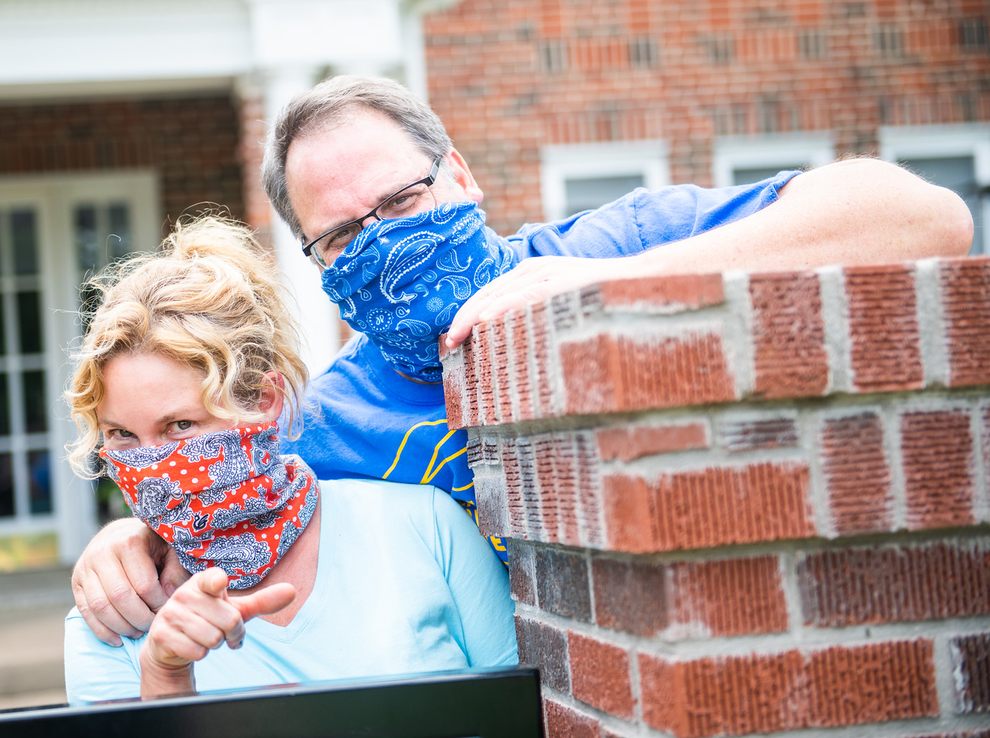
Graduate Tuition & Fees
Academic Year 2019-2020
 | In-state | Prior Year | Out-of-State | Prior Year
Average Tuition | $3,630 | $3,630 | $11,232 | $11,100
Required Fees | $2,948 | $2,794 | $2,948 | $2,794
Dollars Per Credit Hour | $202 | $202 | $624 | $617
Source: IPEDS Institutional Characteristics 2016-17

Slide 17
Top Degrees Conferred
Academic Year 2018-19
Level | Major | Degrees Awarded
Undergraduate | Applied Arts & Sciences | 374
 | Interdisciplinary Studies | 230
 | Liberal Studies | 157
 | Business Administration & Management | 106
 | Kinesiology And Exercise Science | 102
 | Psychology | 79
 | Criminal Justice | 68
 | Accounting | 47
 | Social Work | 44
 | General Business | 40
Master | Business Administration & Management | 322
 | Accounting | 128
 | Computer & Information Sciences | 111
 | Business Analytics | 106
 | Educational Administration & Supervision | 96
 | Curriculum and Instruction | 84
 | Social Work | 78
 | Counseling | 56
 | Educational Technology - Library Science | 50
 | Kinesiology And Exercise Science | 42
Doctoral | Educational Administration & Supervision | 30
 | Counseling | 15
 | Higher Education Administration | 10
 | Elementary Teacher Education | 8
 | English Language & Literature | 6
 | Educational Psychology | 1
Source: CBM009, Certified Data

Slide 18
Degrees Awarded
By Gender and Degree Level
Academic Year | Gender | Baccalaureate | Master | Doctoral | Total
2014-2015 | Men | 516 | 586 | 18 | 1,120
 | Women | 960 | 859 | 37 | 1,856
Total |  | 1,476 | 1,445 | 55 | 2,976
2015-2016 | Men | 614 | 672 | 14 | 1,300
 | Women | 1,062 | 909 | 25 | 1,996
Total |  | 1,676 | 1,581 | 39 | 3,296
2016-2017 | Men | 543 | 715 | 6 | 1,264
 | Women | 1,123 | 1,006 | 23 | 2,152
Total |  | 1,666 | 1,721 | 29 | 3,416
2017-2018 | Men | 597 | 573 | 21 | 1,191
 | Women | 1,194 | 950 | 38 | 2,182
Total |  | 1,791 | 1,523 | 59 | 3,373
2018-2019 | Men | 613 | 566 | 20 | 1,199
 | Women | 1,160 | 944 | 50 | 2,154
Total |  | 1,773 | 1,510 | 70 | 3,353
Source: CBM009, Certified Data

Slide 19
Student/Faculty Ratio by College
Fall 2019
College/School | FTSE | FTE | Ratio
College of agricultural sciences and natural resources | 254.87 | 12.51 | 20:1
College of business | 1,544.43 | 56.38 | 27:1
College of education & human services | 2,165.22 | 120.72 | 18:1
College of humanities, social sciences & arts | 1.992.55 | 110.23 | 18:1
College of Innovation and Design | 393.32 | 24.83 | 16:1
College of science & engineering | 1,852.20 | 77.74 | 24:1
Total: Texas A&M University-Commerce | 8,202.59 | 402.41 | 20:1
FTSE: Full-Time Student Equivalent, CBM001, Certified
FTE: Full-Time Faculty Equivalent, Local Data

Slide 20
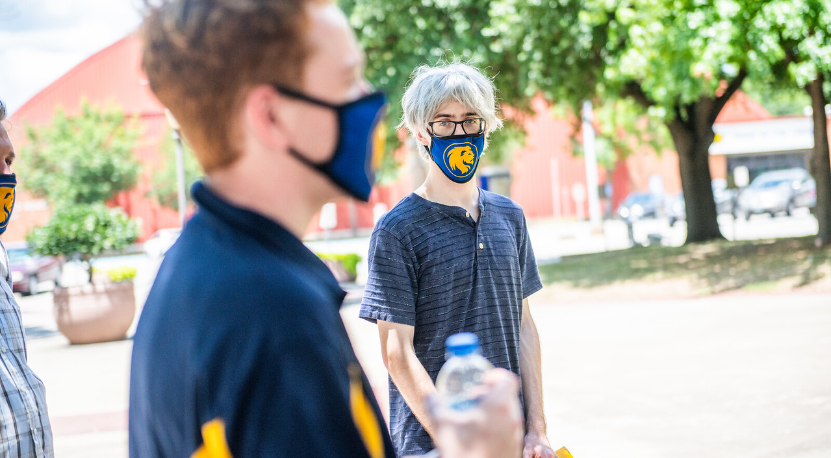
Employment Characteristics
Fall 2019
 | Part time | Full time | TOTAL
Faculty | 282 | 394 | 676
Staff | 25 | 525 | 550
Total | 307 | 919 | 1,226
Source: IPEDS-Human Resources

