Slide 1
FAST FACTS
INSTITUTIONAL RESEARCH
Academic Year 2020-2021
Source: http://www.tamuc.edu/IER

Slide 2
New Freshman Applied Admitted & Enrolled by gender
Fall 2020
 | Male | Percent* | Female | Percent* | Total | Total Percent*
Applied | 3401 |  | 5185 |  | 8586
Admitted | 2020 | 59.39% | 3131 | 60.39% | 5151 | 59.99%
Enrolled | 368 | 18.22% | 519 | 16.58% | 887 | 17.22%
*Admitted as a percentage of Applied, and Enrolled as Percentage of Admitted.
Source: Local Banner Data, not certified

Slide 3
SAT/ACT Comparison for Enrolled Students
Fall 2020
SAT Evidence Based Reading and Writing
SAT Math
ACT Composite
Source: Local Banner Data, not certified; only tests taken in 2020 included.
SAT Averages from The College Board 2020 Report
ACT Average from The Condition of College & Career Readiness 2019 (no 2020 report was produced)
Notes:
SAT Writing data is not available for 2017.

Slide 4
One Year PERSISTENCE Rate
First-Time, Full-Time Undergraduate
Entering Cohort Fall 2019, as of Fall 2020
 | Count | Persistence Rate
Same institution | 692 | 66.2%
Other Texas institution | 125 | 12.0%
Total | 817 | 78.2%
Source: Accountability Report

Slide 5
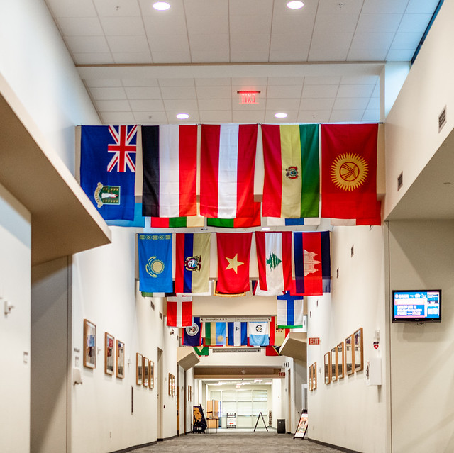
Graduation Rate as of 2020
 | ENTERING FALL COHORT | COUNT | PERCENT
4-Year Graduation Rate | 2016 | 1,011 | 29.6%
* Same Institution |  |  | 25.9%
* Other Texas Institution |  |  | 3.7%
5-Year Graduation Rate | 2015 | 1,006 | 47.5%
* Same Institution |  |  | 38.4%
* Other Texas Institution |  |  | 9.1%
6-Year Graduation Rate | 2014 | 991 | 52.4%
* Same Institution |  |  | 43.0%
* Other Texas Institution |  |  | 9.4%
Source: Accountability Report

Slide 6
Top Feeder Schools
First Time in College Fall 2020
High School | # Enrolled
Greenville High School | 25
Royse City High School | 25
Commerce High School | 21
Texas Home-Schooled | 18
North Forney High School | 13
Caddo Mills High School | 12
Desoto High School | 12
Lancaster High School | 12
Mesquite High School | 12
David W Carter High School | 11
Source: CBM001, Certified Data

Slide 7
Age Distribution by Level
Fall 2020
Age | Undergraduate | Post Baccalaureate | Masters | Doctoral | Total | Percent
Under 18 | 495 | 0 | 0 | 0 | 495 | 4.26%
18-24 | 5243 | 11 | 481 | 3 | 5738 | 49.36%
25-29 | 843 | 17 | 776 | 33 | 1669 | 14.36%
30-39 | 785 | 31 | 1020 | 161 | 1997 | 17.18%
40-49 | 400 | 19 | 529 | 181 | 1129 | 9.71%
50 or older | 196 | 22 | 262 | 116 | 596 | 5.13%
Total | 7962 | 100 | 3068 | 494 | 11624 | 100%
Source: CBM001, Certified Data

Slide 8
Enrollment by Demographic
Fall 2020
By Gender
FEMALE
7,246
62.34%
MALE
4,378
37.66%
Source: CBM001, Certified Data

Slide 9
Enrollment by Demographic
Fall 2020
 | Undergraduate |  | Graduate |  | All Students
Race | Count | Percent | Count | Percent | Count | Percent
White | 3345 | 41.49% | 1737 | 48.76% | 5082 | 43.72%
Black or African-American | 1580 | 19.60% | 626 | 17.57% | 2206 | 18.98%
Hispanic | 1814 | 22.50% | 610 | 17.13% | 2424 | 20.85%
Asian | 142 | 1.76% | 155 | 4.35% | 297 | 2.56%
American Indian or Alaskan Native | 45 | 0.56% | 8 | 0.22% | 53 | 0.46%
Native Hawaiian or Other Pacific Islander | 12 | 0.15% | 2 | 0.06% | 14 | 0.12%
Two or More Races | 575 | 7.13% | 135 | 3.79% | 710 | 6.11%
International | 427 | 5.30% | 222 | 6.23% | 649 | 5.58%
Not Reported | 122 | 1.51% | 67 | 1.88% | 189 | 1.63%
Total | 8062 | 100.00% | 3562 | 100.00% | 11624 | 100%
Source: CBM001, Certified Data

Slide 10
Fall Enrollment Trend
10-Year
YEAR | HEAD COUNT
2011 | 10726
2012 | 11187
2013 | 11068
2014 | 11490
2015 | 12302
2016 | 12385
2017 | 12490
2018 | 12072
2019 | 11725
2020 | 11624
Source: CBM001, Certified Data

Slide 11
First-Time Transfer Students Top Feeder Schools
Fall 2020
Institution | Total
Dallas County Community College | 138
Paris Junior College | 133
Collin County Community College | 62
Trinity Valley Community College | 59
Navarro College | 46
Grayson County College | 37
Blinn College | 35
Tarrant County College | 33
Northeast Texas Community College | 25
Tyler Junior College | 18
Source: CBM001, Certified Data

Slide 12
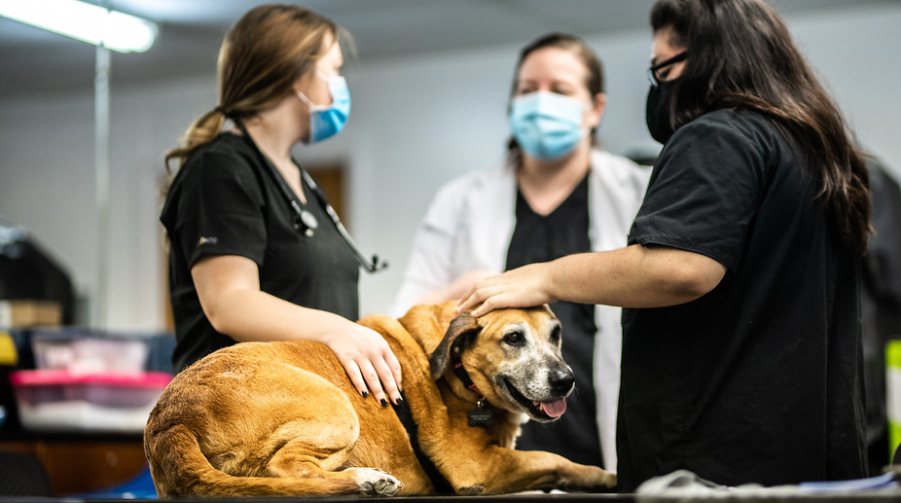
Enrollment by Residency
Fall 2020
Residency | Count | Percent
In State | 10797 | 93%
Out of State | 204 | 2%
International | 623 | 5%
Total | 11,624 | 100%
Source: CBM001, Certified Data

Slide 13
Distribution of Total In-State Enrollment
Fall 2020
Distance | Students | Percent
50 Miles or Less | 5,041 | 47.26%
100 Miles | 4018 | 37.7%
200 Miles | 463 | 4.3%
300 Miles | 773 | 7.2%
400 Miles | 240 | 2.2%
Over 400 Miles | 136 | 1.3%
Total | 10,671 | 100%
Source: CBM001, Certified Data. All Degree Levels

Slide 14
Enrollment BY geographic origin
Fall 2020
Top 10 Counties
Top 10 States
Top 10 Countries
County | # Enrolled
Dallas | 2387
Hunt | 1296
Collin | 1190
Rockwall | 614
Tarrant | 591
Kaufman | 396
Denton | 373
Hopkins | 306
Harris | 281
Lamar | 262
State | # Enrolled
Texas | 10797
California | 27
Arkansas | 21
Oklahoma | 21
Louisiana | 12
Virginia | 11
Colorado | 9
Florida | 8
Washington | 7
Georgia | 6
Country | # Enrolled
United States | 11001
Nepal | 337
India | 94
Korea | 47
Nigeria | 27
Bangladesh | 7
Canada | 6
Ivory Coast | 6
Ghana | 6
Germany | 5
Source: CBM001, Certified Data. All Degree Levels

Slide 15
Top Program AREAS by Level Fall 2020
Classification | # Enrolled |  | Program AREAS
Undergraduate
 | 782 |  | Interdisciplinary Studies, General
 | 607 |  | Applied Arts & Sciences
 | 467 |  | Kinesiology and Exercise Science
 | 431 |  | Criminal Justice/Safety Studies
 | 413 |  | Business Administration and Management
 | 320 |  | Computer and Information Sciences, General
 | 292 |  | Psychology, General
 | 275 |  | Music, General
 | 250 |  | Animal Sciences, General
 | 214 |  | Biological Sciences
GRADUATE
 | 555 |  | Business Administration and Management, General
 | 264 |  | Accounting
 | 206 |  | Business Analytics
 | 164 |  | Curriculum and Instruction
 | 161 |  | Counselor Education/School Counseling and Guidance Services
 | 131 |  | Educational Leadership and Administration, General
 | 124 |  | Higher Education Administration
 | 120 |  | Social Work
 | 109 |  | Computer and Information Sciences, General
 | 93 |  | Kinesiology and Exercise Science
Doctoral
 | 209 |  | Educational Leadership and Administration, General
 | 85 |  | Higher Education Administration
 | 56 |  | Counselor Education/School Counseling and Guidance Services
 | 47 |  | Elementary Education and Teaching
 | 39 |  | English Language and Literature, General
 | 33 |  | Educational Psychology
Source: CBM001, Certified Data.

Slide 16
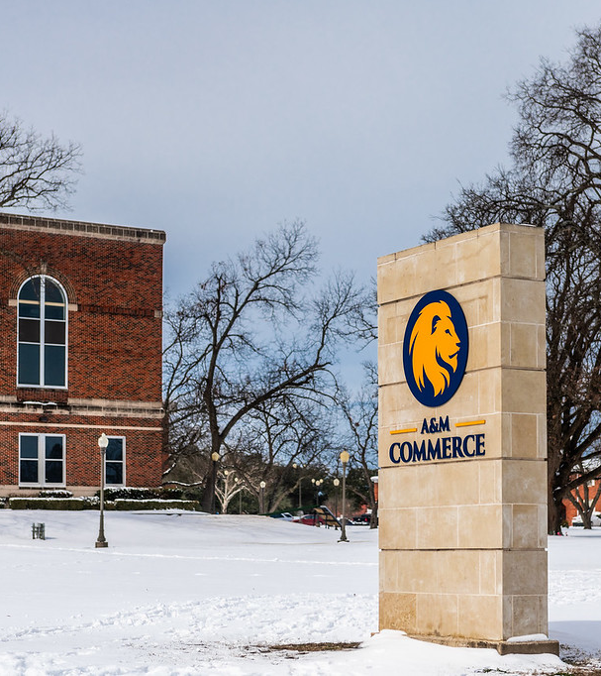
Undergraduate Tuition & Fees
Academic Year 2020-2021
 | In-state | Prior Year | Out-of-State | Prior Year
Average Tuition | $4,790 | $4,790 | $17,060 | $17,460
Required Fees | $5,030 | $4,168 | $5,030 | $4,168
Dollars Per Credit Hour | $160 | $160 | $569 | $582
Source: IPEDS Institutional Characteristics 2020-21

Slide 17
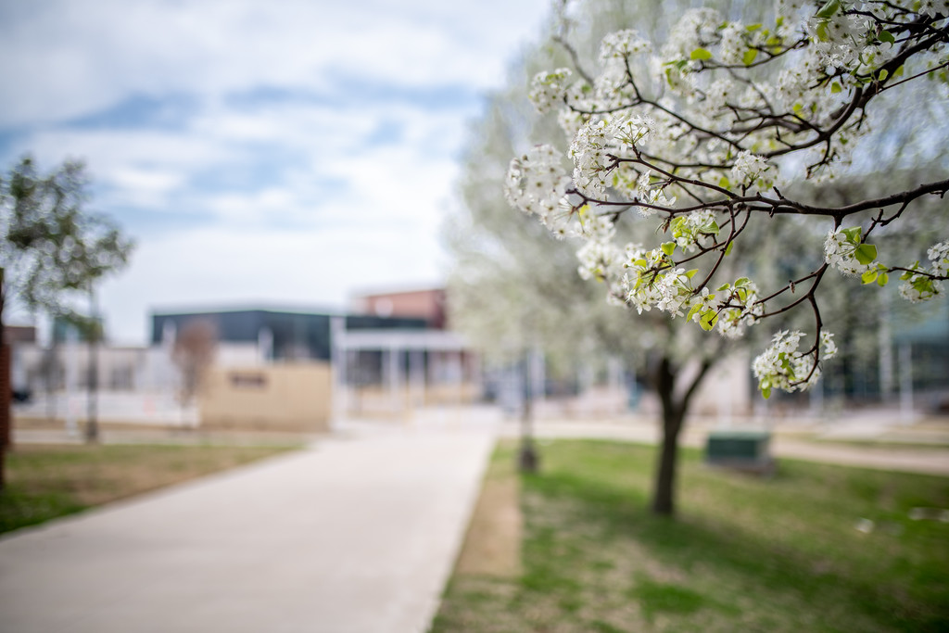
Graduate Tuition & Fees
Academic Year 2020-2021
 | In-state | Prior Year | Out-of-State | Prior Year
Average Tuition | $3,630 | $3,630 | $10,992 | $11,232
Required Fees | $3,557 | $2,948 | $3,557 | $2,948
Dollars Per Credit Hour | $202 | $202 | $611 | $624
Source: IPEDS Institutional Characteristics 2020-21

Slide 18
Top Degrees Conferred
Academic Year 2019-20
Level | Major | Degrees Awarded
Undergraduate | Applied Arts & Sciences | 375
 | Interdisciplinary Studies | 233
 | Liberal Studies | 123
 | Business Administration & Management | 120
 | Kinesiology And Exercise Science | 91
 | Criminal Justice | 83
 | Psychology | 54
 | Social Work | 53
 | Music | 40
 | Computer & Information Sciences | 38
Master | Business Administration & Management | 257
 | Accounting | 138
 | Business Analytics | 90
 | Computer & Information Sciences | 64
 | Educational Administration & Supervision | 64
 | Social Work | 62
 | Library Science | 58
 | Curriculum and Instruction | 55
 | Counseling | 45
 | Higher Education Administration | 41
Doctoral | Educational Administration & Supervision | 26
 | Higher Education Administration | 14
 | Counseling | 11
 | Elementary Teacher Education | 5
 | English Language & Literature | 4
 | Educational Psychology | 2
Source: CBM009, Certified Data

Slide 19
Degrees Awarded
By Gender and Degree Level
Academic Year | Gender | Baccalaureate | Master | Doctoral | Total
2015-2016 | Men | 614 | 672 | 14 | 1,300
 | Women | 1,062 | 909 | 25 | 1,996
Total |  | 1,676 | 1,581 | 39 | 3,296
2016-2017 | Men | 543 | 715 | 6 | 1,264
 | Women | 1,123 | 1,006 | 23 | 2,152
Total |  | 1,666 | 1,721 | 29 | 3,416
2017-2018 | Men | 597 | 573 | 21 | 1,191
 | Women | 1,194 | 950 | 38 | 2,182
Total |  | 1,791 | 1,523 | 59 | 3,373
2018-2019 | Men | 613 | 566 | 20 | 1,199
 | Women | 1,160 | 944 | 50 | 2,154
Total |  | 1,773 | 1,510 | 70 | 3,353
2019-2020 | Men | 688 | 430 | 12 | 1,130
 | Women | 1,109 | 831 | 50 | 1,990
Total |  | 1,797 | 1,261 | 62 | 3,120
Source: CBM009, Certified Data

Slide 20
Student/Faculty Ratio by College
Fall 2020
College/School | FTSE | FTE | Ratio
College of agricultural sciences and natural resources | 346.18 | 16.28 | 21:1
College of business | 1,584.22 | 45.72 | 34:1
College of education & human services | 2,308.75 | 123.60 | 18:1
College of humanities, social sciences & arts | 1,907.35 | 107.51 | 17:1
College of Innovation and Design | 396.97 | 23.84 | 16:1
College of science & engineering | 1,944.52 | 83.20 | 23:1
Total: Texas A&M University-Commerce | 8,481.98 | 400.15 | 21:1
FTSE: Full-Time Student Equivalent, CBM001, Certified
FTE: Full-Time Faculty Equivalent, Local Data

Slide 21
Employment Characteristics
Fall 2020
 | Part time | Full time | TOTAL
Faculty | 324 | 370 | 694
Staff | 34 | 533 | 567
Total | 358 | 903 | 1,261
Source: IPEDS-Human Resources

