Slide 1
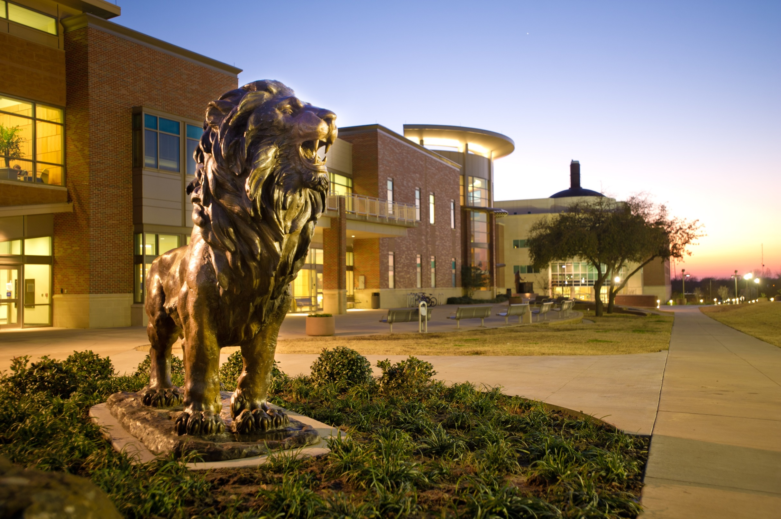
FAST FACTS
INSTITUTIONAL RESEARCH
Academic Year 2016-2017
Source: http://www.tamuc.edu/IER

Slide 2

New Freshman Applied
Admitted & Enrolled by gender
Fall 2016
 | Male | Percent* | Female | Percent* | Total | Total Percent*
Applied | 3340 |  | 4460 |  | 7800
Admitted | 1518 | 45% | 2082 | 47% | 3600 | 46%
Enrolled | 513 | 34% | 578 | 28% | 1091 | 30%
*Admitted as a percentage of Applied, and Enrolled as Percentage of Admitted.
Source: Local Banner Data, not certified

Slide 3
SAT/ACT Comparison for Enrolled Students
Fall 2016
SAT Reading
SAT Math
-6.7% Difference
-10.0% Difference
494
466
-0.6% Difference
508
-3.5% Difference
463
478
462
Test | TAMUC Average | National Average | Difference | State Average | Difference
SAT Reading | 458 | 495 | -7.47% | 470 | -2.55%
SAT Math | 467 | 511 | -8.89% | 486 | -4.04%
SAT Writing | 436 | 484 | -9.70% | 454 | -3.83%
ACT Composite | 21 | 21 | 0.00% | 21 | 0.00%
SAT Writing
ACT Composite
-8.6% Difference
-4.0% Difference
482
-1.1% Difference
20.8
20.6
-3.0% Difference
449
444
20
Source: Local Banner Data, not certified; only tests taken in 2016 included.
SAT Averages from The College Board

Slide 4

One Year Retention Rate
Full-Time, First-Time Bachelor’s
Entering Cohort Fall 2015
 | Count | Persistence Rate
Same institution | 648 | 64.41%
Other Texas institution | 175 | 17.40%
Total | 823 | 81.81%
Source: Accountability Report

Slide 5
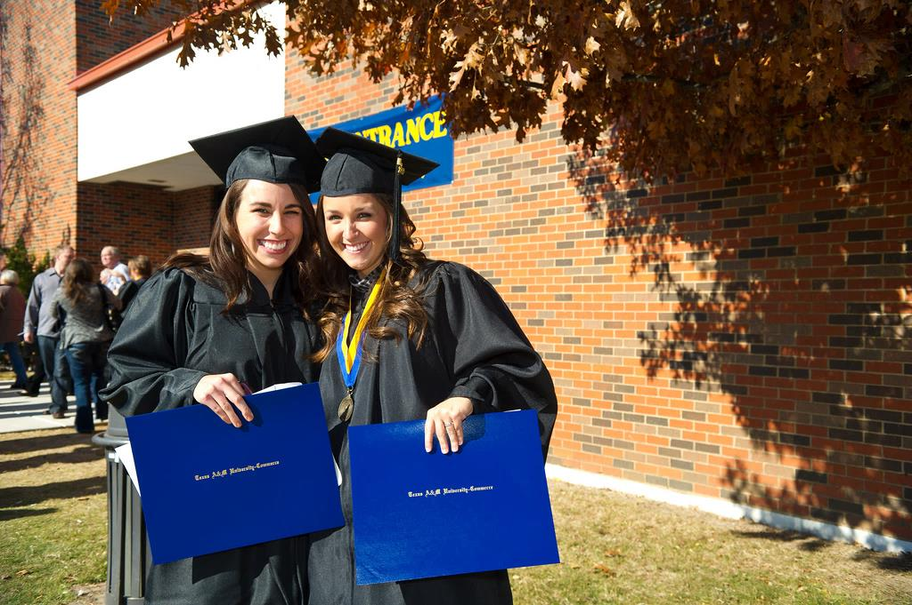
Graduation Rate as of 2016
 | ENTERING FALL COHORT | COUNT | PERCENT
4-Year Graduation Rate | 2012 | 811 | 27.87%
* Same Institution |  |  | 24.41%
* Other Texas Institution |  |  | 3.45%
5-Year Graduation Rate | 2011 | 667 | 43.18%
* Same Institution |  |  | 38.38%
* Other Texas Institution |  |  | 4.80%
6-Year Graduation Rate | 2010 | 597 | 48.91%
* Same Institution |  |  | 43.38%
* Other Texas Institution |  |  | 5.53%
Source: Accountability Report

Slide 6
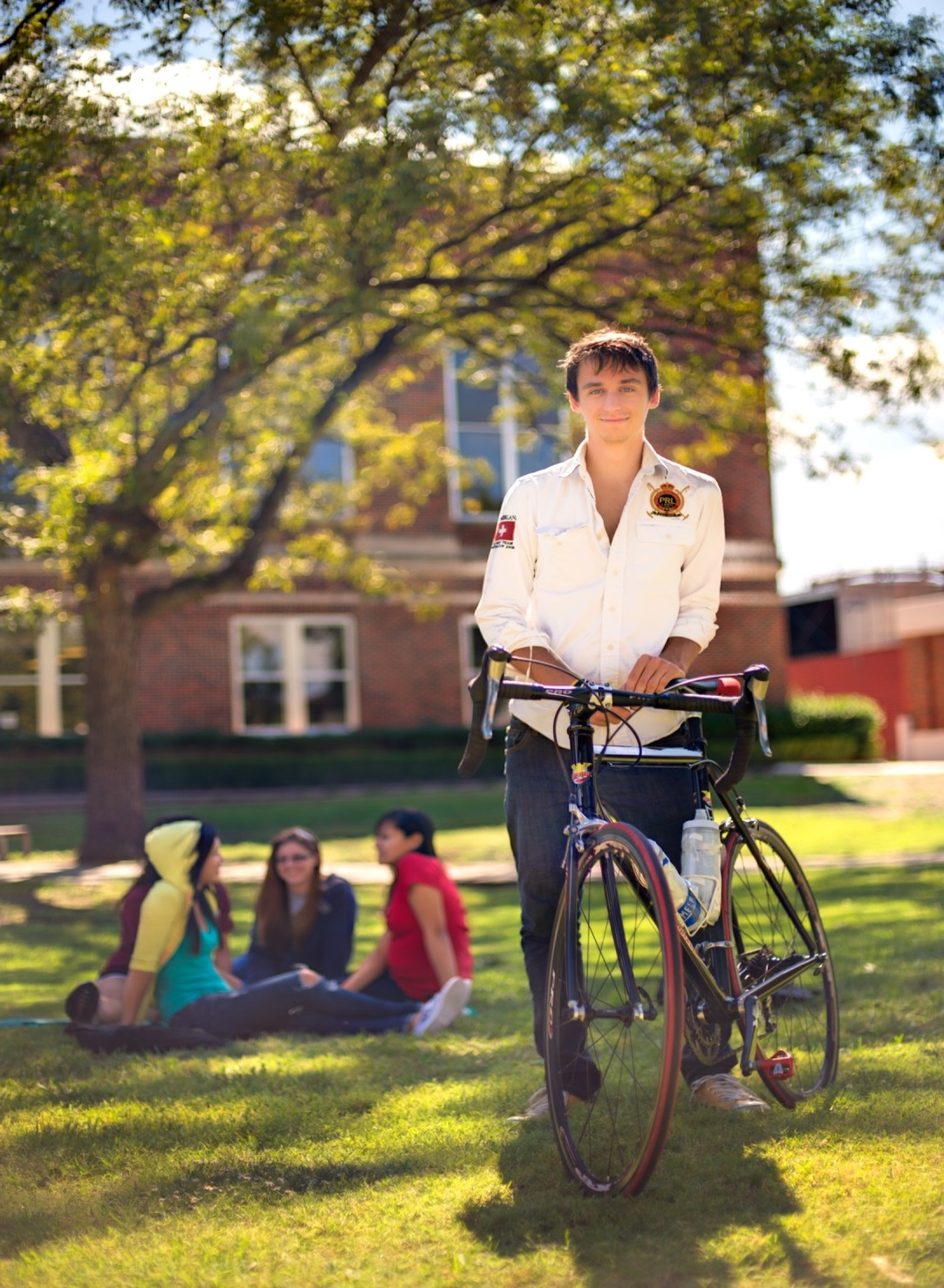
Top Feeder Schools
First Time Freshman Fall 2016
High School | #Enrolled
Rowlett High School | 16
Summit International Prep | 16
Cedar Hill High School | 15
Lancaster High School | 14
Poteet High School | 14
West Mesquite High School | 14
Rains High School | 13
Skyline High School | 13
South Garland High School | 13
Sulphur Springs High School | 13
Source: CBM001, Certified Data

Slide 7
Overall Headcount Enrollment
by College and Classification
Fall 2016
TOTAL 3,214 PERCENT 25.95%
228
TOTAL 4,105 Percent 33.14%
330
221
1566
465
728
TOTAL 252 PERCENT 2.03%
6
82
71
TOTAL 2,886 PERCENT 23.30%
49
50
TOTAL 1,928 PERCENT 15.57%
47
493
284
75
974
746
241
482
303
425
390
343
11
Source: CBM001, Certified Data

Slide 8
Age Distribution by Level
Fall 2016
Age | Undergraduate | Masters | Post Baccalaureate | Doctoral | Total | Percent
Under 18 | 308 | 0 | 0 | 0 | 308 | 2.49%
18-25 | 5,410 | 997 | 21 | 8 | 6,436 | 51.97%
26-30 | 747 | 971 | 38 | 71 | 1,827 | 14.75%
31-35 | 427 | 727 | 11 | 106 | 1,271 | 10.26%
36-40 | 266 | 476 | 15 | 105 | 862 | 6.96%
41-50 | 329 | 637 | 22 | 203 | 1,191 | 9.62%
51-70 | 116 | 232 | 12 | 124 | 484 | 3.91%
Above 70 | 2 | 2 | 0 | 2 | 6 | 0.05%
Total | 7,605 | 4,042 | 119 | 619 | 12,385 | 100%
Source: CBM001, Certified Data

Slide 9
Enrollment by Demographic
Fall 2016
By Gender
White: 46.91%
American Indian or Alaskan Native: 0.55%
FEMALE
Unknown/Not Reported: 1.39%
7,524
60.75%
Asian: 2.591%
Multiracial: 6.80%
Black or African American: 20.10%
International: 6.80%
Hispanic: 16.84%
MALE
4,861
39.25%
Source: CBM001, Certified Data

Slide 10
Fall Enrollment Trend
10-Year
YEAR | HEAD COUNT
2007 | 8,879
2008 | 8,787
2009 | 9,075
2010 | 10,280
2011 | 10,726
2012 | 11,187
2013 | 11,068
2014 | 11,490
2015 | 12,302
2016 | 12,385
Source: CBM001, Certified Data

Slide 11

First-Time Transfer Students
Top Feeder Schools
Fall 2016
Institution | Total
Dallas County Community College District | 174
Paris Junior College | 173
Navarro College | 109
Trinity Valley Community College | 63
Collin County Community College | 56
Tarrant County College | 34
Grayson County College | 32
Foreign | 31
Northeast Texas Community College | 27
Blinn College | 19
University of North Texas | 19
Source: CBM001, Certified Data

Slide 12

Enrollment by Residency
Fall 2016
Residency | Count | Percent
In State | 11,388 | 91.95%
Out of State | 232 | 1.87%
International | 765 | 6.18%
Total | 12,385 | 100%
Source: CBM001, Certified Data

Slide 13
Distribution of Total In-State Enrollment
Fall 2016
Distance | Students | Percent
100 Miles or Less | 9,101 | 79.92%
200 Miles | 436 | 3.83%
300 Miles | 752 | 6.60%
400 Miles | 678 | 5.95%
500 Miles | 45 | 0.40%
Over 500 Miles | 376 | 3.30%
Total | 11, 388 | 100%
45
0.40%
9,101
79.92%
752
6.60%
678
5.95%
436
3.83%
376
3.30%
Source: CBM001, Certified Data. All Degree Levels

Slide 14
Enrollment
Fall 2016
Top 10 Counties
Top 10 States
Top 10 Countries
County | # Enrolled
Dallas | 2,719
Hunt | 1,294
Collin | 1,226
Tarrant | 633
Rockwall | 596
Hopkins | 400
Kaufman | 374
Lamar | 342
Denton | 333
Ellis | 322
Total | 8,239
State | # Enrolled
CALIFORNIA | 33
OKLAHOMA | 28
ARKANSAS | 17
LOUISIANA | 14
MISSOURI | 11
GEORGIA | 9
NEW YORK | 9
FLORIDA | 8
MICHIGAN | 7
COLORADO | 6
Total | 142
Country | # Enrolled
INDIA | 482
KOREA | 71
NIGERIA | 27
CHINA | 24
NEPAL | 22
BANGLADESH | 10
KIRIBATI | 7
PAKISTAN | 7
JAPAN | 6
NIGER | 6
Total | 662
6
North Carolina
Kansas
141 Total Out-of-State Enrolled
Source: CBM001, Certified Data. All Degree Levels

Slide 15
Top Program AREAS by Level
Fall 2016
Classification | # Enrolled |  | Program AREAS
Undergraduate
 | 1044 |  | Interdisciplinary Studies, General
 | 808 |  | Undeclared Major
 | 561 |  | Kinesiology and Exercise Science
 | 498 |  | Business Administration and Management, General
 | 354 |  | Psychology, General
 | 333 |  | Criminal Justice/Safety Studies
 | 285 |  | Applied Arts & Sciences
 | 244 |  | Music, General
 | 237 |  | Biology/Biological Sciences, General
 | 216 |  | Accounting
GRADUATE
 | 858 |  | Business Administration and Management, General
 | 405 |  | Accounting
 | 312 |  | Computer and Information Sciences, General
 | 267 |  | Curriculum and Instruction
 | 231 |  | Undeclared Major
 | 205 |  | Educational Leadership and Administration, General
 | 160 |  | Business Analytics
 | 154 |  | Counselor Education/School Counseling and Guidance
 | 121 |  | Social Work
 | 117 |  | Industrial Technology/Technician
Doctoral
 | 262 |  | Educational Leadership and Administration, General
 | 121 |  | Higher Education/Higher Education Administration
 | 84 |  | Elementary Education and Teaching
 | 68 |  | Counselor Education/School Counseling and Guidance Services
 | 47 |  | English Language and Literature, General
 | 37 |  | Educational Psychology
Source: CBM001, Certified Data.

Slide 16

Undergraduate Tuition & Fees
Academic Year 2016-2017
 | In-district | Prior Year | In-state | Prior Year | Out-of-State
Average Tuition | $4,790 | $3,832 | $4,790 | $3,832 | $17,030
Required Fees | $2,960 | $2,370 | $2,960 | $2,370 | $2,960
Dollars Per Credit Hour | $160 | $160 | $160 | $160 | $568
Source: IPEDS Institutional Characteristics 2016-17

Slide 17

Graduate Tuition & Fees
Academic Year 2016-2017
 | In-district | Prior Year | In-state | Prior Year | Out-of-State
Average Tuition | $3,630 | $3,630 | $3,630 | $3,630 | $10,974
Required Fees | $2,146 | $1,870 | $2,146 | $1,870 | $2,146
$ Per Credit Hour | $202 | $202 | $202 | $202 | $610
Source: IPEDS Institutional Characteristics 2016-17

Slide 18
Top Degrees Conferred
Academic Year 2015-16
Level | Major | Degrees Awarded
Undergraduate | Applied Arts & Sciences | 289
 | Interdisciplinary | 254
 | Liberal Studies | 156
 | Business Administration & Management | 102
 | Psychology, General | 84
 | Criminal Justice Studies | 78
 | Kinesiology and Exercise Science | 77
 | Social Work | 71
 | Accounting | 50
 | Biology | 37
Master | Business Administration | 462
 | Computer & Information Sciences, General | 173
 | Educational Technology | 124
 | Educational Administration | 117
 | Accounting | 102
 | Social Work | 89
 | Counseling Education/Std Counseling & Guidance Services | 53
 | Computational Science | 51
 | Industrial Technology | 49
 | Educational Technology | 28
 | Kinesiology and Exercise Science | 28
Doctoral | Educational Administration | 12
 | Higher Education Administration | 9
 | English Language & Literature | 8
 | Counseling Education/Std Counseling & Guidance Services | 6
 | Elementary Teacher Education | 2
 | Educational Psychology | 2
Source: CBM009, Certified Data

Slide 19
Degrees Awarded by College
Academic Year 2015-2016
College | Degree Level | Fall | Spring | Summer | Total | Percent
College of Business | Baccalaureate | 214 | 258 | 144 | 616
 | Master | 233 | 251 | 133 | 617
Total |  | 447 | 509 | 277 | 1,233 | 37.41%
College of Education & Human Services | Baccalaureate | 252 | 240 | 28 | 520
 | Master | 271 | 178 | 130 | 579
 | Doctoral | 13 | 11 | 7 | 31
Total |  | 536 | 429 | 165 | 1,130 | 34.28%
College of Humanities, Social Sciences & Arts | Baccalaureate | 97 | 168 | 53 | 318
 | Master | 19 | 31 | 16 | 66
 | Doctoral | 2 | 3 | 3 | 8
Total |  | 118 | 202 | 72 | 392 | 11.89%
College of Science & Engineering | Baccalaureate | 47 | 99 | 25 | 171
 | Master | 112 | 129 | 62 | 303
Total |  | 159 | 228 | 87 | 474 | 14.39%
School of Agriculture | Baccalaureate | 15 | 23 | 13 | 51
 | Master | 3 | 4 | 9 | 16
Total |  | 18 | 27 | 22 | 67 | 2.22%
Total Texas A&M University-Commerce |  | 1,278 | 1,395 | 623 | 3,296 | 100%
Source: CBM009, Certified Data

Slide 20
Degrees Awarded
By Gender and Degree Level
Academic Year | Gender | Baccalaureate | Master | Doctoral | Total
2011-2012 | Female | 986 | 804 | 24 | 1,814
 | Male | 521 | 599 | 10 | 1,130
Total |  | 1,507 | 1,403 | 34 | 2,944
2012-2013 | Female | 1,009 | 932 | 69 | 2,010
 | Male | 510 | 715 | 25 | 1,250
Total |  | 1,519 | 1,647 | 94 | 3,260
2013-2014 | Female | 915 | 916 | 38 | 1,869
 | Male | 523 | 660 | 27 | 1,210
Total |  | 1,438 | 1,576 | 65 | 3,079
2014-2015 | Female | 960 | 859 | 37 | 1,856
 | Male | 516 | 586 | 18 | 1,120
Total |  | 1,476 | 1,445 | 55 | 2,976
2015-2016 | Female | 1,062 | 909 | 25 | 1,996
 | Male | 614 | 672 | 14 | 1,300
Total |  | 1,676 | 1,581 | 39 | 3,296
Source: CBM009, Certified Data

Slide 21

Student/Faculty Ratio by College
Fall 2016
College/School | FTSE | FTE | Ratio
College of Business | 1,643.27 | 62.39 | 26:1
College of Education & Human Services | 2,669.40 | 135.16 | 19:1
College of Humanities, Social Sciences & Arts | 2,147.76 | 119.01 | 18:1
College of Science & Engineering | 2,038.92 | 87.83 | 23:1
School of Agriculture | 247.75 | 10.80 | 22:1
Total: Texas A&M University-Commerce | 8,747.09 | 415.19 | 21:1
FTSE: Full-Time Student Equivalent, CBM001, Certified
FTE: Full-Time Faculty Equivalent, Local Data

Slide 22

Employment Characteristics
Academic Year 2016-2017
 | Part time | Full time | TOTAL
Faculty | 252 | 353 | 605
Staff | 21 | 492 | 513
Total | 273 | 845 | 1,118
Source: IPEDS-Human Resources

