Slide 1
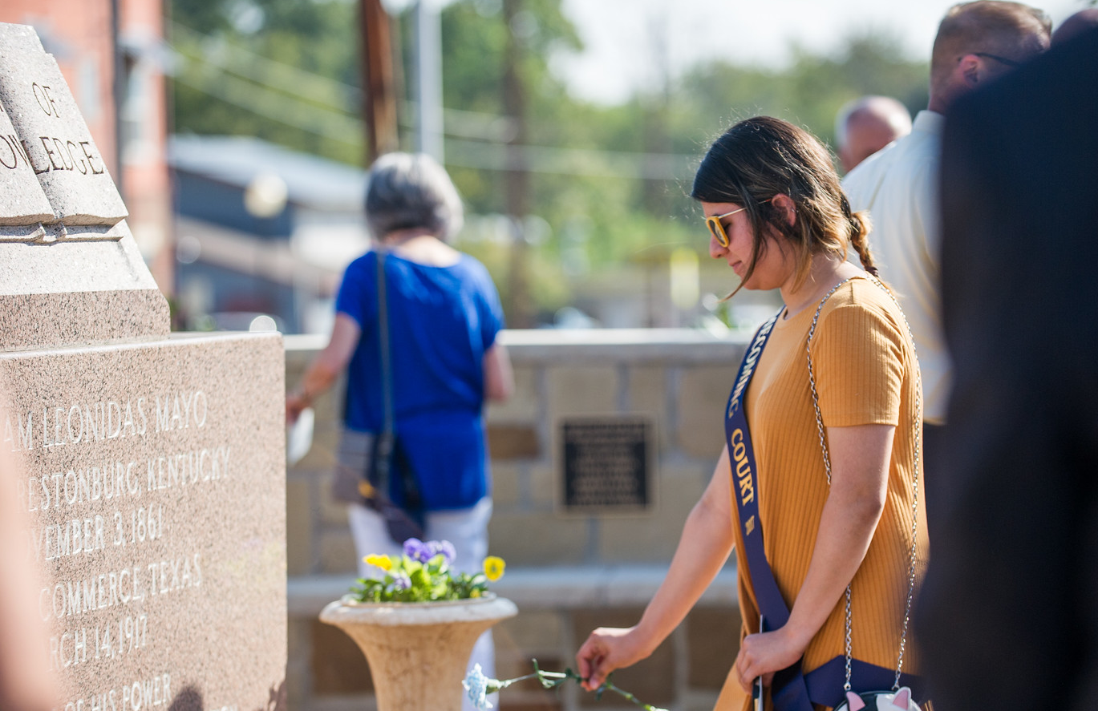
FAST FACTS
INSTITUTIONAL RESEARCH
Academic Year 2017-2018
Source: http://www.tamuc.edu/IER

Slide 2
New Freshman Applied Admitted & Enrolled by gender
Fall 2017
 | Male | Percent* | Female | Percent* | Total | Total Percent*
Applied | 4079 |  | 5651 |  | 9730
Admitted | 1329 | 33% | 1994 | 35% | 3323 | 34%
Enrolled | 527 | 40% | 688 | 35% | 1215 | 37%
*Admitted as a percentage of Applied, and Enrolled as Percentage of Admitted.
Source: Local Banner Data, not certified

Slide 3
SAT/ACT Comparison for Enrolled Students
Fall 2017
SAT Reading
SAT Math
494
466
463
527
507
516
SAT Writing
ACT Composite
482
21.0
20.7
20.1
449
444
Source: Local Banner Data, not certified; only tests taken in 2017 included.
SAT Averages from The College Board
Notes:
SAT Writing data is not available for 2017.

Slide 4
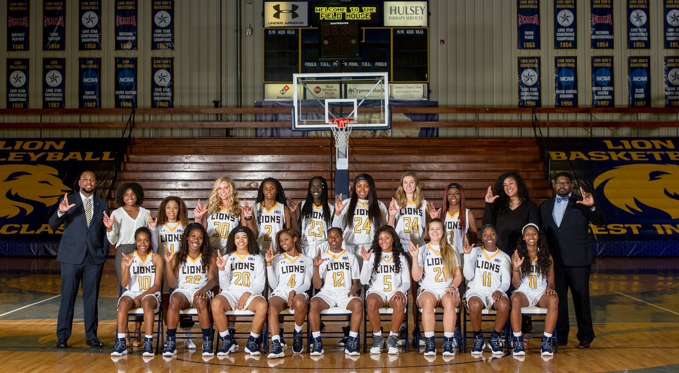
One Year Retention Rate
Full-Time, First-Time Bachelor’s
Entering Cohort Fall 2017
 | Count | Persistence Rate
Same institution | 701 | 51.90%
Other Texas institution | 135 | 20.70%
Total | 836 | 72.6%
Source: Accountability Report
Notes:
Total cohort isn’t mentioned in the white ppt so persistence rate may differ.

Slide 5
Graduation Rate as of 2017
 | ENTERING FALL COHORT | COUNT | PERCENT
4-Year Graduation Rate | 2013 | 928 | 28.3%
* Same Institution |  |  | 25.1%
* Other Texas Institution |  |  | 3.2%
5-Year Graduation Rate | 2012 | 825 | 41.9%
* Same Institution |  |  | 35.0%
* Other Texas Institution |  |  | 6.9%
6-Year Graduation Rate | 2011 | 667 | 49.9%
* Same Institution |  |  | 41.7%
* Other Texas Institution |  |  | 8.2%
Source: Accountability Report

Slide 6
Top Feeder Schools
First Time in College Fall 2017
High School | # Enrolled
Sulphur Springs High School | 34
Dr. John D Horn High School | 23
Rockwall High School | 23
Skyline High School | 23
Desoto High School | 20
Ford High School | 17
Lancaster High School | 16
Rowlett High School | 15
Mesquite High School | 14
Cooper High School | 13
Source: CBM001, Certified Data

Slide 7
Overall Headcount Enrollment
by College and Classification
Fall 2017
TOTAL 3,483 PERCENT 27.88%
267
TOTAL 4,105 Percent 33.14%
268
1528
599
814
TOTAL 230 PERCENT 1.84%
6
76
51
TOTAL 2,961 PERCENT 23.70%
46
57
TOTAL 1,737 PERCENT 13.90%
46
462
261
63
1068
543
235
476
310
423
423
9
379
Source: CBM001, Certified Data
Notes:
% of share per college is calculated by total number students enrolled for 2017 i.e. 12490. Could not update College of Education %share – 4079/12490 = 32.65% but the pie chart is updated.

Slide 8
Age Distribution by Level
Fall 2017
Age | Undergraduate | Masters | Post Baccalaureate | Doctoral | Total | Percent
Under 18 | 407 | 0 | 0 | 0 | 407 | 3.26%
18-25 | 5644 | 873 | 17 | 4 | 6538 | 52.35%
26-30 | 772 | 925 | 17 | 58 | 1772 | 14.19%
31-35 | 449 | 682 | 15 | 103 | 1249 | 10.00%
36-40 | 284 | 490 | 11 | 104 | 889 | 7.12%
41-50 | 340 | 569 | 22 | 211 | 1142 | 9.14%
51-70 | 134 | 212 | 13 | 128 | 487 | 3.90%
Above 70 | 1 | 4 | 0 | 1 | 6 | 0.05%
Total | 8,031 | 3755 | 95 | 609 | 12490 | 100%
Source: CBM001, Certified Data

Slide 9
Enrollment by Demographic
Fall 2017
By Gender
White: 46.19%
American Indian or Alaskan Native: 0.50%
FEMALE
Unknown/Not Reported: 1.24%
7,673
61.43%
Asian: 2.37%
Multiracial: 5.29%
Black or African American: 20.78%
International: 5.53%
Hispanic: 17.97%
MALE
4,817
38.57%
Source: CBM001, Certified Data

Slide 10
Fall Enrollment Trend
10-Year
YEAR | HEAD COUNT
2008 | 8,787
2009 | 9,075
2010 | 10,280
2011 | 10,726
2012 | 11,187
2013 | 11,068
2014 | 11,490
2015 | 12,302
2016 | 12,385
2017 | 12,490
Source: CBM001, Certified Data

Slide 11
First-Time Transfer Students Top Feeder Schools
Fall 2017
Institution | Total
Dallas County Community College District | 154
Paris Junior College | 153
Navarro College | 109
Collin County Community College | 90
Trinity Valley Community College | 54
Tarrant County College | 31
Grayson County College | 29
Blinn College | 23
Foreign | 22
University of North Texas | 21
Source: CBM001, Certified Data

Slide 12
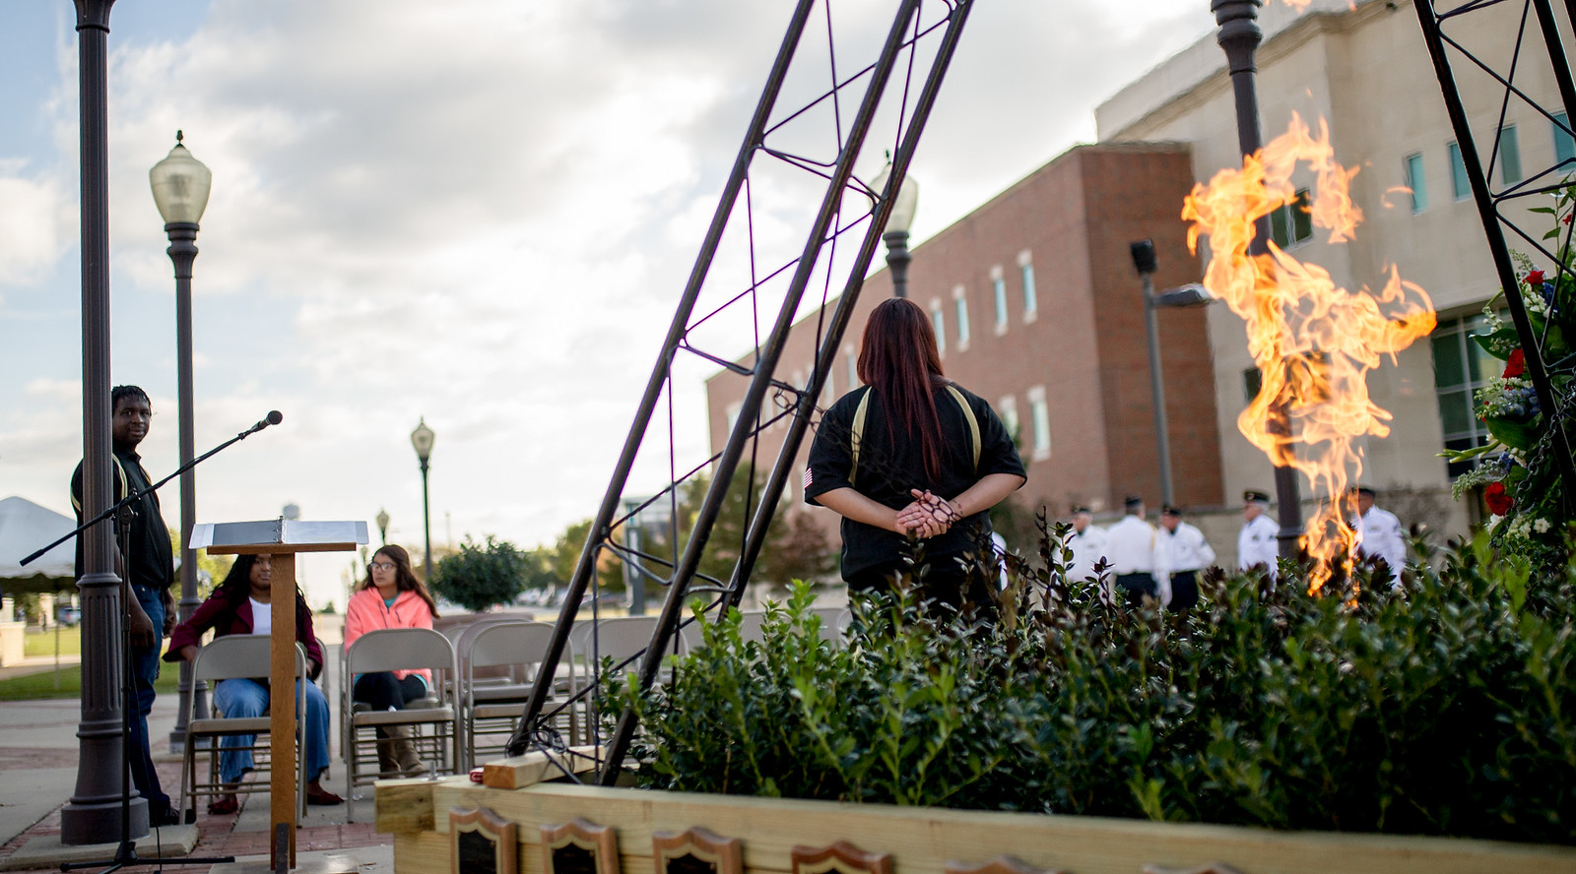
Enrollment by Residency
Fall 2017
Residency | Count | Percent
In State | 11,633 | 93.14%
Out of State | 238 | 1.91%
International | 619 | 4.96%
Total | 12,490 | 100%
Source: CBM001, Certified Data

Slide 13
Distribution of Total In-State Enrollment
Fall 2017
Distance | Students | Percent
100 Miles or Less | 10310 | 88.63%
200 Miles | 256 | 2.20%
300 Miles | 609 | 5.23%
400 Miles | 390 | 3.35%
500 Miles | 29 | 0.25%
Over 500 Miles | 38 | 0.33%
Total | 11, 632 | 100%
Source: CBM001, Certified Data. All Degree Levels

Slide 14
Enrollment
Fall 2017
Top 10 Counties
Top 10 States
Top 10 Countries
County | # Enrolled
Dallas | 2,719
Collin | 1,374
Hunt | 1,174
Tarrant | 682
Rockwall | 540
Hopkins | 408
Kaufman | 382
Denton | 377
Ellis | 313
Harris | 293
State | # Enrolled
TEXAS | 11632
OKLAHOMA | 29
CALIFORNIA | 26
LOUISIANA | 17
ARKANSAS | 18
FLORIDA | 15
MISSOURI | 12
PENNSYLVANIA | 10
GEORGIA | 9
COLORADO | 7
Country | # Enrolled
UNITED STATES | 11872
INDIA | 334
KOREA | 70
NIGERIA | 42
NEPAL | 23
CHINA | 14
BANGLADESH | 12
JAPAN | 6
KUWAIT | 6
PAKISTAN | 6
Source: CBM001, Certified Data. All Degree Levels

Slide 15
Top Program AREAS by Level Fall 2017
Classification | # Enrolled |  | Program AREAS
Undergraduate
 | 1007 |  | Undeclared Major
 | 983 |  | Interdisciplinary Studies, General
 | 574 |  | Kinesiology and Exercise Science
 | 526 |  | Business Administration and Management, General
 | 478 |  | Applied Arts & Sciences
 | 362 |  | Psychology, General
 | 302 |  | Criminal Justice/Safety Studies
 | 254 |  | Music, General
 | 217 |  | Biology/Biological Sciences, General
 | 216 |  | Social Work
GRADUATE
 | 747 |  | Business Administration and Management, General
 | 401 |  | Accounting
 | 228 |  | Computer and Information Sciences, General
 | 222 |  | Business Analytics
 | 204 |  | Curriculum and Instruction
 | 199 |  | Educational Leadership and Administration, General
 | 174 |  | Counselor Education/School Counseling and Guidance
 | 114 |  | Social Work
 | 113 |  | Library and Information Science
 | 110 |  | Undeclared Major
Doctoral
 | 250 |  | Educational Leadership and Administration, General
 | 126 |  | Higher Education/Higher Education Administration
 | 79 |  | Elementary Education and Teaching
 | 71 |  | Counselor Education/School Counseling and Guidance Services
 | 46 |  | English Language and Literature, General
 | 37 |  | Educational Psychology
Source: CBM001, Certified Data.

Slide 16
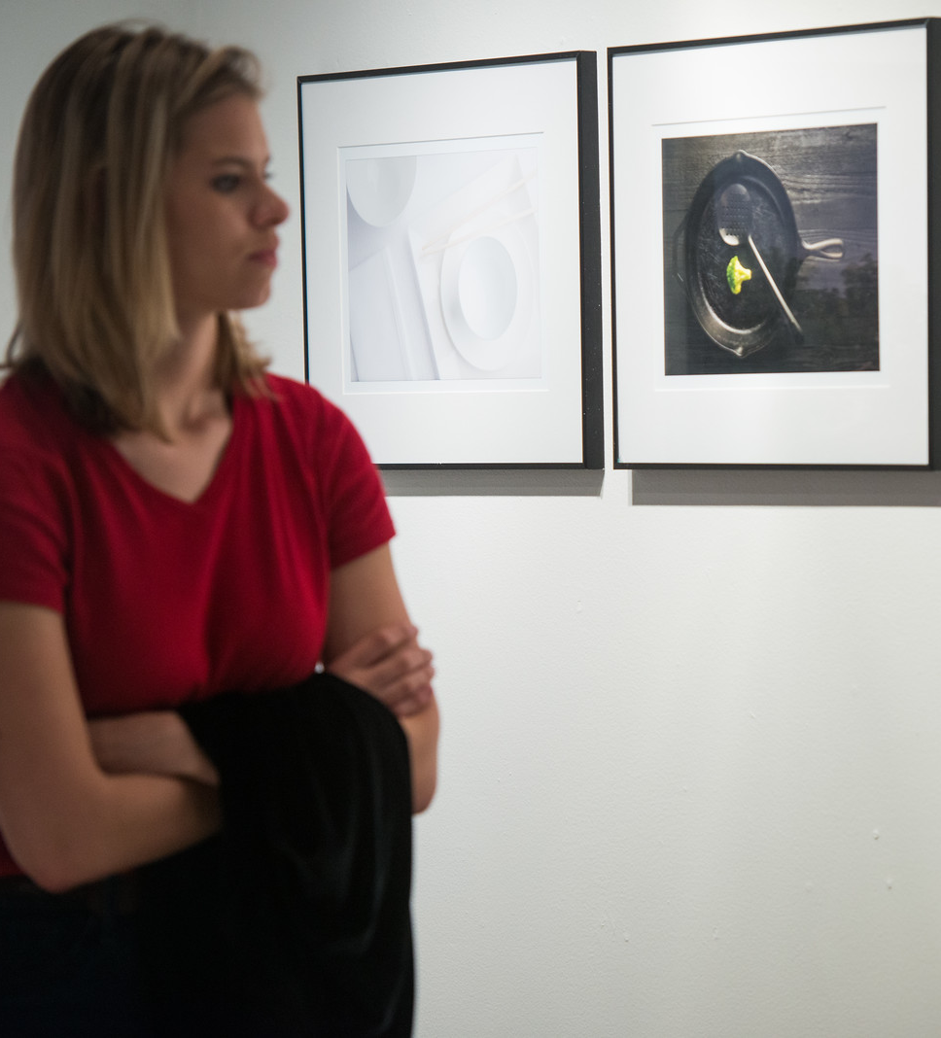
Undergraduate Tuition & Fees
Academic Year 2017-2018
 | In-district | Prior Year | In-state | Prior Year | Out-of-State
Average Tuition | $4,790 | $4,790 | $4,790 | $4,790 | $17,240
Required Fees | $3,958 | $2,960 | $3,958 | $2,960 | $3,958
Dollars Per Credit Hour | $160 | $160 | $160 | $160 | $575
Source: IPEDS Institutional Characteristics 2016-17

Slide 17
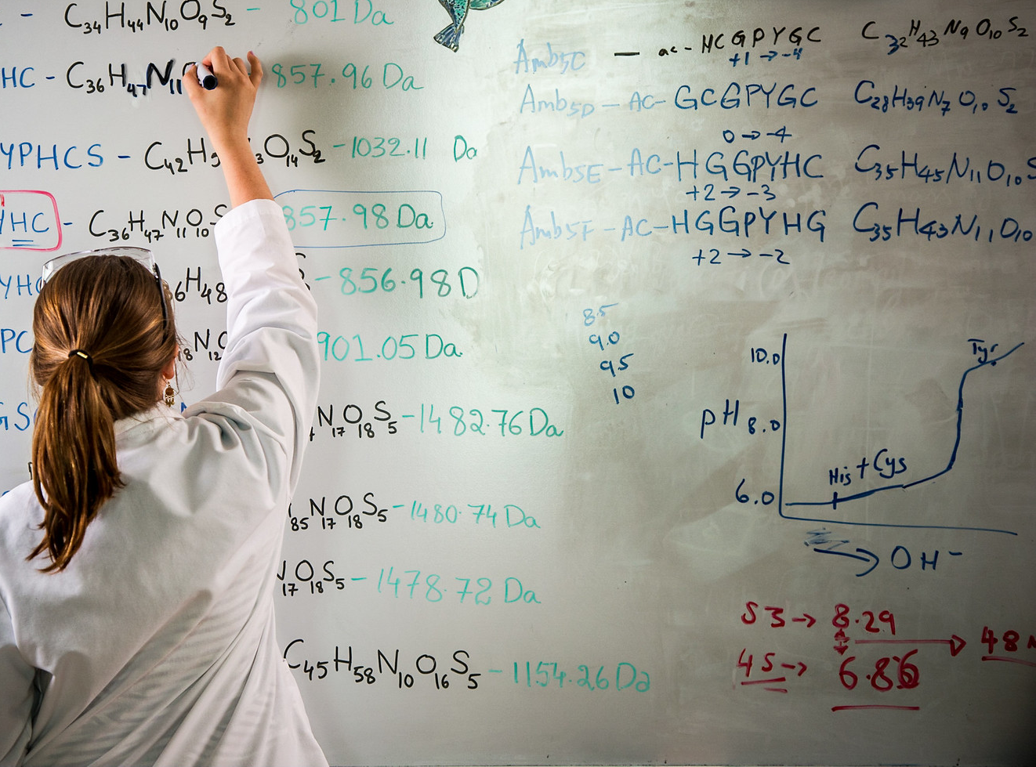
Graduate Tuition & Fees
Academic Year 2017-2018
 | In-district | Prior Year | In-state | Prior Year | Out-of-State
Average Tuition | $3,630 | $3,630 | $3,630 | $3,630 | $11,100
Required Fees | $2,564 | $1,870 | $2,564 | $1,870 | $2,564
$ Per Credit Hour | $202 | $202 | $202 | $202 | $610
Source: IPEDS Institutional Characteristics 2016-17

Slide 18
Top Degrees Conferred
Academic Year 2017-18
Level | Major | Degrees Awarded
Undergraduate | Applied Arts & Sciences | 318
 | Interdisciplinary | 253
 | Liberal Studies | 138
 | Kinesiology And Exercise Science | 102
 | Psychology, General | 93
 | Business Administration and Management | 77
 | Criminal Justice Studies | 66
 | Social Work | 57
 | Accounting | 51
 | Biology | 34
Master | Business Administration | 446
 | Computer & Information Sciences, General | 176
 | Educational Technology | 129
 | Educational Administration | 127
 | Accounting | 124
 | Industrial Technology | 67
 | Social Work | 66
 | Business Analytics | 59
 | Computation Science | 37
 | Coun Educ/Std Coun & Guid Srvc | 37
 | Kinesiology and Exercise Science | 35
Doctoral | Educational Administration | 8
 | Higher Education Administration | 7
 | English Language & Literature | 5
 | Educational Psychology | 4
 | Coun Educ/Std Coun & Guid Srvc | 3
 | Elementary Teacher Education | 2
Source: CBM009, Certified Data

Slide 19
Degrees Awarded by College
Academic Year 2017-2018
College | Degree Level | Fall | Spring | Summer | Total | Percent
College of Business | Baccalaureate | 224 | 252 | 132 | 608
 | Master | 272 | 267 | 147 | 686
Total |  | 496 | 519 | 279 | 1,294 | 37.88%
College of Education & Human Services | Baccalaureate | 249 | 242 | 39 | 530
 | Master | 236 | 201 | 127 | 564
 | Doctoral | 11 | 8 | 5 | 24
Total |  | 496 | 451 | 171 | 1,118 | 32.73%
College of Humanities, Social Sciences & Arts | Baccalaureate | 100 | 144 | 51 | 295
 | Master | 16 | 36 | 53 | 105
 | Doctoral | 0 | 4 | 1 | 5
Total |  | 116 | 184 | 105 | 405 | 11.86%
College of Science & Engineering | Baccalaureate | 45 | 88 | 15 | 148
 | Master | 152 | 136 | 53 | 341
Total |  | 197 | 224 | 68 | 489 | 14.31%
COLLEGE OF AGRICULTURAL SCIENCES AND NATURAL RESOURCES | Baccalaureate | 28 | 39 | 18 | 85
 | Master | 3 | 11 | 11 | 25
Total |  | 31 | 50 | 29 | 110 | 3.22%
Total Texas A&M University-Commerce |  | 1,336 | 1,428 | 652 | 3,416 | 100%
Source: CBM009, Certified Data

Slide 20
Degrees Awarded
By Gender and Degree Level
Academic Year | Gender | Baccalaureate | Master | Doctoral | Total
2012-2013 | Female | 1,009 | 932 | 69 | 2,010
 | Male | 510 | 715 | 25 | 1,250
Total |  | 1,519 | 1,647 | 94 | 3,260
2013-2014 | Female | 915 | 916 | 38 | 1,869
 | Male | 523 | 660 | 27 | 1,210
Total |  | 1,438 | 1,576 | 65 | 3,079
2014-2015 | Female | 960 | 859 | 37 | 1,856
 | Male | 516 | 586 | 18 | 1,120
Total |  | 1,476 | 1,445 | 55 | 2,976
2015-2016 | Female | 1,062 | 909 | 25 | 1,996
 | Male | 614 | 672 | 14 | 1,300
Total |  | 1,676 | 1,581 | 39 | 3,296
2016-2017 | Female | 1,123 | 1,006 | 23 | 2,152
 | Male | 543 | 715 | 6 | 1,264
Total |  | 1,666 | 1,721 | 29 | 3,416
Grand Total |  | 9,282 | 9,373 | 316 | 18,971
Source: CBM009, Certified Data

Slide 21
Student/Faculty Ratio by College
Fall 2017
College/School | FTSE | FTE | Ratio
College of agricultural sciences and natural resources | 223.77 | 12.24 | 18:1
College of business | 1,695.27 | 68.48 | 24:1
College of education & human services | 2,724.52 | 96.53 | 28:1
College of humanities, social sciences & arts | 2,256.32 | 136.11 | 17:1
College of science & engineering | 1,949.75 | 87.52 | 22:1
Total: Texas A&M University-Commerce | 8,849.62 | 400.88 | 22:1
FTSE: Full-Time Student Equivalent, CBM001, Certified
FTE: Full-Time Faculty Equivalent, Local Data

Slide 22
Employment Characteristics
Academic Year 2017-2018
 | Part time | Full time | TOTAL
Faculty | 252 | 353 | 605
Staff | 21 | 492 | 513
Total | 273 | 845 | 1,118
Source: IPEDS-Human Resources

