Slide 1
FAST FACTS
INSTITUTIONAL RESEARCH
Academic Year 2018-2019
Source: http://www.tamuc.edu/IER

Slide 2
New Freshman Applied Admitted & Enrolled by gender
Fall 2018
 | Male | Percent* | Female | Percent* | Total | Total Percent*
Applied | 4191 |  | 6113 |  | 10304
Admitted | 1431 | 34% | 2052 | 34% | 3483 | 34%
Enrolled | 540 | 38% | 719 | 35% | 1259 | 36%
*Admitted as a percentage of Applied, and Enrolled as Percentage of Admitted.
Source: Local Banner Data, not certified

Slide 3
SAT/ACT Comparison for Enrolled Students
Fall 2018
SAT Evidence Based Reading and Writing
SAT Math
ACT Composite
Source: Local Banner Data, not certified; only tests taken in 2018 included.
SAT Averages from The College Board 2018 Report
Notes:
SAT Writing data is not available for 2017.

Slide 4
One Year PERSISTENCE Rate
First-Time, Full-Time Undergraduate
Entering Cohort Fall 2017, as of Fall 2018
 | Count | Persistence Rate
Same institution | 760 | 72.6%
Other Texas institution | 101 | 9.7%
Total | 860 | 82.2%
Source: Accountability Report
Notes:
Total cohort isn’t mentioned in the white ppt so persistence rate may differ.

Slide 5
Graduation Rate as of 2018
 | ENTERING FALL COHORT | COUNT | PERCENT
4-Year Graduation Rate | 2014 | 991 | 31.4%
* Same Institution |  |  | 27.9%
* Other Texas Institution |  |  | 3.5%
5-Year Graduation Rate | 2013 | 928 | 46.0%
* Same Institution |  |  | 38.5%
* Other Texas Institution |  |  | 7.5%
6-Year Graduation Rate | 2012 | 825 | 49.0%
* Same Institution |  |  | 40.0%
* Other Texas Institution |  |  | 9.0%
Source: Accountability Report

Slide 6
Top Feeder Schools
First Time in College Fall 2018
High School | # Enrolled
Desoto High School | 31
Lancaster High School | 23
Commerce High School | 22
David W. Carter High School | 19
Dr. John D Horn High School | 18
Sulphur Springs High School | 17
Rockwall High School | 16
Sachse High School | 16
Greenville High School | 15
North Garland High School | 15
Source: CBM001, Certified Data

Slide 7
Overall Headcount Enrollment
by College and Classification
Fall 2018
Total: 3470
Total: 3792
Total: 313
Total: 2915
Total: 1645
Source: CBM001, Certified Data
Notes:
% of share per college is calculated by total number students enrolled for 2017 i.e. 12490. Could not update College of Education %share – 4079/12490 = 32.65% but the pie chart is updated.

Slide 8
Age Distribution by Level
Fall 2018
Age | Undergraduate | Post Baccalaureate | Masters | Doctoral | Total | Percent
Under 18 | 413 | 0 | 0 | 0 | 413 | 3.42%
18-24 | 5460 | 8 | 564 | 0 | 6032 | 49.97%
25-29 | 878 | 20 | 887 | 29 | 1814 | 15.03%
30-39 | 817 | 34 | 1049 | 188 | 2088 | 17.30%
40-49 | 387 | 20 | 568 | 174 | 1149 | 9.52%
50 or older | 178 | 21 | 243 | 134 | 576 | 4.77%
Total | 8,133 | 103 | 3311 | 525 | 12072 | 100%
Source: CBM001, Certified Data

Slide 9
Enrollment by Demographic
Fall 2018
By Gender
FEMALE
7479
61.95%
MALE
4,593
38.05%
Source: CBM001, Certified Data

Slide 10
Fall Enrollment Trend
10-Year
YEAR | HEAD COUNT
2009 | 9075
2010 | 10280
2011 | 10726
2012 | 11187
2013 | 11068
2014 | 11490
2015 | 12302
2016 | 12385
2017 | 12490
2018 | 12072
Source: CBM001, Certified Data

Slide 11
First-Time Transfer Students Top Feeder Schools
Fall 2018
Institution | Total
Paris Junior College | 162
Dallas County Community College | 155
Collin County Community College | 110
Navarro College | 77
Trinity Valley Community College | 66
Tarrant County College | 31
University Of North Texas | 29
Blinn College | 27
Northeast Texas Community College | 27
Tyler Junior College | 27
Source: CBM001, Certified Data

Slide 12
Enrollment by Residency
Fall 2018
Residency | Count | Percent
In State | 11363 | 94%
Out of State | 222 | 2%
International | 487 | 4%
Total | 12,072 | 100%
Source: CBM001, Certified Data

Slide 13
Distribution of Total In-State Enrollment
Fall 2018
Distance | Students | Percent
50 Miles or Less | 8346 | 73.4%
100 Miles | 1658 | 14.6%
200 Miles | 262 | 2.3%
300 Miles | 634 | 5.6%
400 Miles | 383 | 3.4%
Over 400 Miles | 80 | 0.7%
Total | 11363 | 100%
Source: CBM001, Certified Data. All Degree Levels

Slide 14
Enrollment BY geographic origin
Fall 2018
Top 10 Counties
Top 10 States
Top 10 Countries
County | # Enrolled
Dallas | 2621
Hunt | 1275
Collin | 1211
Tarrant | 682
Rockwall | 535
Hopkins | 393
Denton | 383
Kaufman | 351
Harris | 325
Lamar | 279
State | # Enrolled
Texas | 11363
California | 33
Oklahoma | 26
Louisiana | 18
Arkansas | 16
Illinois | 10
Pennsylvania | 9
Missouri | 8
Virginia | 8
Florida | 7
Country | # Enrolled
United States | 11585
India | 222
Korea | 58
Nigeria | 40
Nepal | 39
Bangladesh | 14
China | 12
Vietnam | 9
United Kingdom | 6
Iran | 5
Source: CBM001, Certified Data. All Degree Levels

Slide 15
Top Program AREAS by Level Fall 2018
Classification | # Enrolled |  | Program AREAS
Undergraduate
 | 1026 |  | Undeclared Major
 | 908 |  | Interdisciplinary Studies, General
 | 671 |  | Applied Arts & Sciences
 | 590 |  | Kinesiology and Exercise Science
 | 517 |  | Business Administration and Management, General
 | 331 |  | Psychology, General
 | 294 |  | Criminal Justice/Safety Studies
 | 274 |  | Music, General
 | 238 |  | Biology/Biological Sciences, General
 | 235 |  | Animal Sciences, General
GRADUATE
 | 636 |  | Business Administration and Management, General
 | 350 |  | Accounting
 | 200 |  | Business Analytics
 | 175 |  | Computer and Information Sciences, General
 | 159 |  | Counselor Education/School Counseling and Guidance Services
 | 156 |  | Curriculum and Instruction
 | 146 |  | Educational Leadership and Administration, General
 | 136 |  | Social Work
 | 122 |  | Library and Information Science
 | 102 |  | Undeclared Major
Doctoral
 | 227 |  | Educational Leadership and Administration, General
 | 98 |  | Higher Education/Higher Education Administration
 | 75 |  | Elementary Education and Teaching
 | 59 |  | Counselor Education/School Counseling and Guidance Services
 | 40 |  | English Language and Literature, General
 | 26 |  | Educational Psychology
Source: CBM001, Certified Data.

Slide 16
Undergraduate Tuition & Fees
Academic Year 2018-2019
 | In-district | Prior Year | In-state | Prior Year | Out-of-State
Average Tuition | $4,790 | $4,790 | $4,790 | $4,790 | $17,240
Required Fees | $3,958 | $3,644 | $3,958 | $3,644 | $3,958
Dollars Per Credit Hour | $160 | $160 | $160 | $160 | $575
Source: IPEDS Institutional Characteristics 2017-18

Slide 17
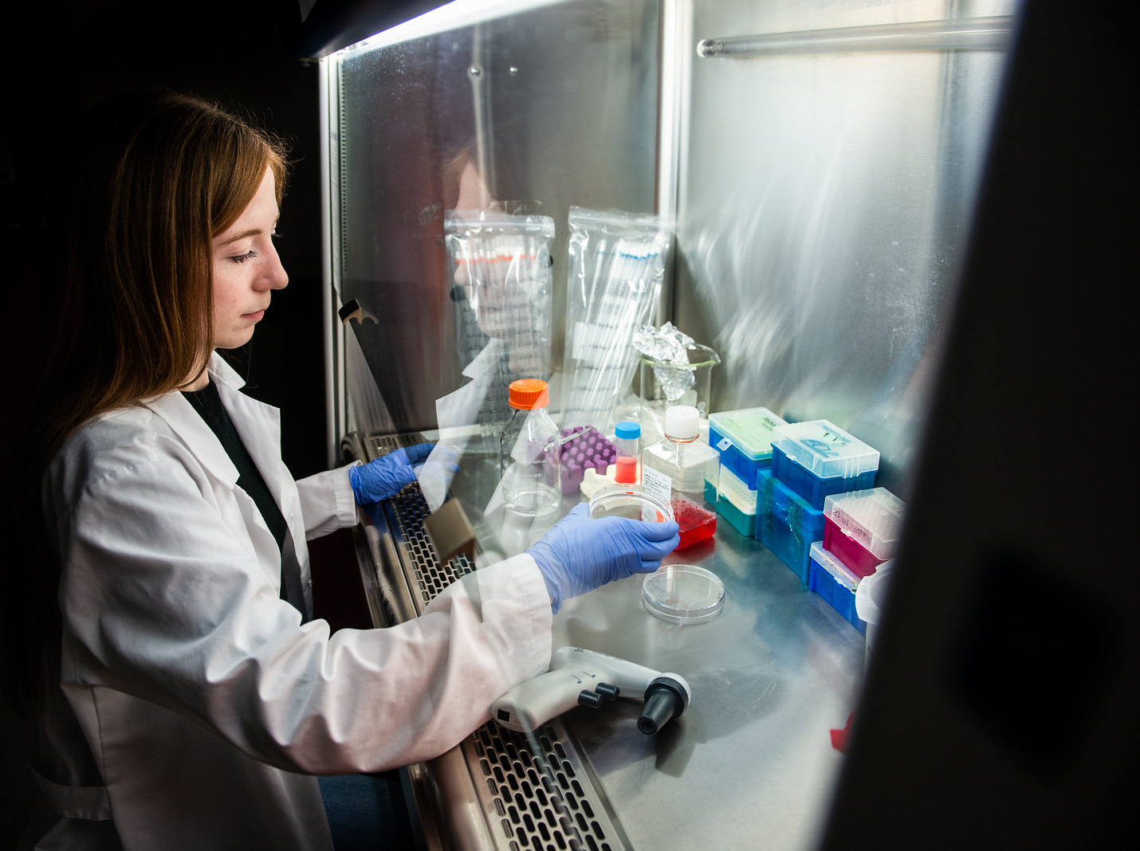
Graduate Tuition & Fees
Academic Year 2018-2019
 | In-district | Prior Year | In-state | Prior Year | Out-of-State
Average Tuition | $3,630 | $3,630 | $3,630 | $3,630 | $11,100
Required Fees | $2,794 | $2,564 | $2,794 | $2,564 | $2,794
Dollars Per Credit Hour | $202 | $202 | $202 | $202 | $617
Source: IPEDS Institutional Characteristics 2016-17

Slide 18
Top Degrees Conferred
Academic Year 2017-18
Level | Major | Degrees Awarded
Undergraduate | Applied Arts & Sciences | 329
 | Interdisciplinary Studies | 251
 | Liberal Studies | 137
 | Kinesiology And Exercise Science | 114
 | Business Administration & Management | 99
 | Psychology | 80
 | Criminal Justice | 65
 | Nursing | 64
 | Social Work | 62
 | Accounting | 45
Master | Business Administration & Management | 325
 | Accounting | 135
 | Educational Administration & Supervision | 131
 | Business Analytics | 106
 | Educational Technology | 102
 | Computer & Information Sciences | 97
 | Social Work | 68
 | Biology | 39
 | Counseling | 37
 | Finance | 36
 | Kinesiology And Exercise Science | 36
Doctoral | Educational Administration & Supervision | 21
 | Counseling | 12
 | Higher Education Administration | 10
 | English Language & Literature | 8
 | Educational Psychology | 7
 | Elementary Teacher Education | 1
Source: CBM009, Certified Data

Slide 19
Degrees Awarded by College
Academic Year 2018-2019
College | Degree Level | Fall | Spring | Summer | Total | Percent
College of Business | Baccalaureate | 248 | 266 | 136 | 650
 | Master | 280 | 243 | 105 | 628
Total |  | 528 | 509 | 241 | 1278 | 38%
College of Education & Human Services | Baccalaureate | 233 | 260 | 79 | 572
 | Master | 240 | 173 | 119 | 532
 | Doctoral | 17 | 22 | 12 | 51
Total |  | 490 | 455 | 210 | 1155 | 34%
College of Humanities, Social Sciences & Arts | Baccalaureate | 101 | 156 | 43 | 300
 | Master | 32 | 65 | 27 | 124
 | Doctoral | 3 | 2 | 3 | 8
Total |  | 136 | 223 | 73 | 432 | 13%
College of Science & Engineering | Baccalaureate | 56 | 119 | 15 | 190
 | Master | 101 | 94 | 23 | 218
Total |  | 157 | 213 | 38 | 408 | 12%
COLLEGE OF AGRICULTURAL SCIENCES AND NATURAL RESOURCES | Baccalaureate | 19 | 44 | 16 | 79
 | Master | 3 | 10 | 8 | 21
Total |  | 22 | 54 | 24 | 100 | 3%
Total Texas A&M University-Commerce |  | 1,333 | 1,454 | 586 | 3,373 | 100%
Source: CBM009, Certified Data

Slide 20
Degrees Awarded
By Gender and Degree Level
Academic Year | Gender | Baccalaureate | Master | Doctoral | Total
2013-2014 | Men | 523 | 660 | 27 | 1,210
 | Women | 915 | 916 | 38 | 1,869
Total |  | 1,438 | 1,576 | 65 | 3,079
2014-2015 | Men | 516 | 586 | 18 | 1,120
 | Women | 960 | 859 | 37 | 1,856
Total |  | 1,476 | 1,445 | 55 | 2,976
2015-2016 | Men | 614 | 672 | 14 | 1,300
 | Women | 1,062 | 909 | 25 | 1,996
Total |  | 1,676 | 1,581 | 39 | 3,296
2016-2017 | Men | 543 | 715 | 6 | 1,264
 | Women | 1,123 | 1,006 | 23 | 2,152
Total |  | 1,666 | 1,721 | 29 | 3,416
2017-2018 | Men | 597 | 573 | 21 | 1,191
 | Women | 1,194 | 950 | 38 | 2,182
Total |  | 1,791 | 1,523 | 59 | 3,373
Source: CBM009, Certified Data

Slide 21
Student/Faculty Ratio by College
Fall 2018
College/School | FTSE | FTE | Ratio
College of agricultural sciences and natural resources | 264.02 | 14.08 | 19:1
College of business | 1,554.45 | 65.42 | 24:1
College of education & human services | 2,520.34 | 133.89 | 19:1
College of humanities, social sciences & arts | 2,267.31 | 96.62 | 23:1
College of science & engineering | 1,879.75 | 86.90 | 22:1
Total: Texas A&M University-Commerce | 8,485.86 | 396.91 | 21:1
FTSE: Full-Time Student Equivalent, CBM001, Certified
FTE: Full-Time Faculty Equivalent, Local Data

Slide 22
2018-2019 IPEDS Human Resources
is not in the IER shared drive as of 3/6/2019
Employment Characteristics
Academic Year 2017-2018
 | Part time | Full time | TOTAL
Faculty | 252 | 353 | 605
Staff | 21 | 492 | 513
Total | 273 | 845 | 1,118
Source: IPEDS-Human Resources

